Slide 1

Charter for the use of AI tools at [Organisation]
Version [number] of [date] · Owner: [function, e.g. the DPO]
[Organisation] · Version [number] of [date] · Owner: [function, e.g. the DPO] · Next review: [date]
Adapted from the example AI charter published by Contee (DoNotLeak) · CC BY-SA 4.0
Notes:
An example charter to adapt: replace every field in [brackets] — PowerPoint's find and replace does it on every page at once, footer included.
Picture: a proposed way of teaching; a signature alone guarantees neither adoption nor compliance.

Slide 2
An example to adapt
PUBLISHED BY DONOTLEAK (CONTEE)
IT IS NOT LEGAL ADVICE
REPLACE EVERY FIELD IN [BRACKETS]
adapt it with your data protection officer (DPO), your legal counsel and, where required, your staff representatives.
to help organisations write their own charter, under the CC BY-SA 4.0 licence (see the end: keep that notice).
and delete this page.
[Organisation] · Version [number] of [date] · Owner: [function, e.g. the DPO] · Next review: [date]
Adapted from the example AI charter published by Contee (DoNotLeak) · CC BY-SA 4.0
Notes:
This page stands for the header box of the text version: delete it once the charter is adapted. The licence notice on the last page stays.

Slide 3
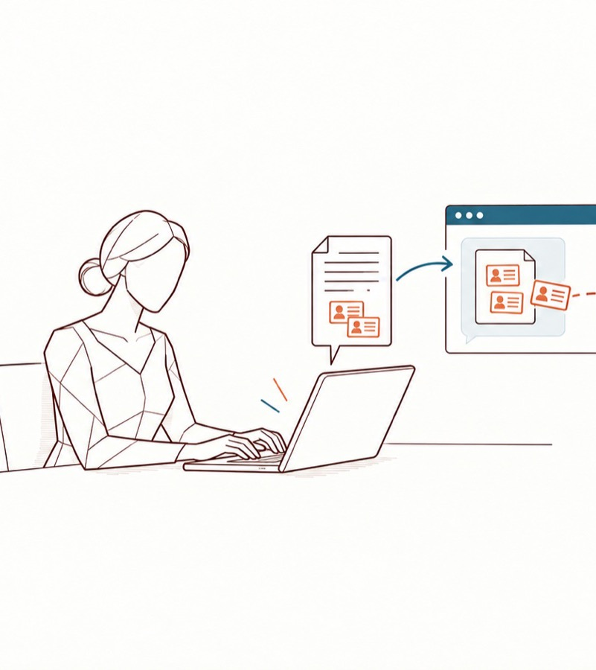
1. Why this charter
AI tools help us write, summarise, translate and code.
What leaves
What we paste into them leaves [Organisation]:
At the provider
depending on the tool, its contract and its settings, the provider may keep it, read it or reuse it.
What this charter says
This charter says which uses are allowed, what must be protected first, and whom to call.
What it sets
It sets out the instructions [Organisation] gives, as controller, to everyone who handles its data.
[Organisation] · Version [number] of [date] · Owner: [function, e.g. the DPO] · Next review: [date]
Adapted from the example AI charter published by Contee (DoNotLeak) · CC BY-SA 4.0
Notes:
GDPR, article 29: anyone acting under the authority of the controller processes the data only on its instructions.
Picture: an illustrative scenario, not a leak observed at a customer.

Slide 4
2. Scope
Who
every employee, intern, temporary worker and contractor acting for [Organisation]; [add: officers, volunteers…].
Which tools
every AI tool used for work — chat assistants, writing and translation tools, code assistants, meeting transcription, AI features built into software already in use — whether [Organisation] provides it or not, on a work or a personal device or account.
Which information
everything [Organisation] holds or receives — about its staff, customers, [patients, pupils…], suppliers and partners — and its contracts, figures, plans, source code and know-how.
[Organisation] · Version [number] of [date] · Owner: [function, e.g. the DPO] · Next review: [date]
Adapted from the example AI charter published by Contee (DoNotLeak) · CC BY-SA 4.0

Slide 5
3. Allowed and forbidden uses
Approved tools
[Function] keeps the list of approved tools, and of the account to use with each, at [location]. A tool that is not on the list is not used with work information until [function] has reviewed it. Ask: the list grows with the requests.
✓ Allowed
with an approved tool, once the text is protected (section 4):
✓ drafting, rewording, summarising and translating;
✓ [add your own cases: reviewing code, preparing a meeting…].
✗ Forbidden
✗ entering information you are not authorised to share outside [Organisation];
✗ using a personal account, or a tool not on the list, with work information;
✗ leaving to an AI a decision about a person (hiring, assessment, credit, care…) without a human review [and without the approval of …];
✗ [add your sector's restrictions: professional secrecy, classified information…].
Always
check what the AI returns — errors, invented facts, bias — before using it. You remain the author of what you send and of what you do with the answer.
[Organisation] · Version [number] of [date] · Owner: [function, e.g. the DPO] · Next review: [date]
Adapted from the example AI charter published by Contee (DoNotLeak) · CC BY-SA 4.0
Notes:
Two columns: what is allowed, what is forbidden. The list of approved tools lives elsewhere (intranet, wiki): it changes more often than the charter.

Slide 6
4. Protect before any AI use
Before a text or a document reaches an AI tool:
1. REPLACE WHAT IDENTIFIES A PERSON
3. REMOVE WHAT [ORGANISATION] HAS PROMISED
5. SHARE ONLY WHAT THE TASK NEEDS
names, email and postal addresses, phone numbers, dates of birth, identification numbers, bank details (IBAN, card numbers), health information.
to keep confidential: documents received under a non-disclosure agreement, tenders, prices, contracts, source code, strategy.
an AI rarely needs a real name to answer.
4. CHECK THE HIDDEN PARTS OF A FILE
2. REMOVE SECRETS
passwords, access keys and tokens, internal addresses and server names.
comments, tracked changes, metadata, hidden sheets.
[Organisation] · Version [number] of [date] · Owner: [function, e.g. the DPO] · Next review: [date]
Adapted from the example AI charter published by Contee (DoNotLeak) · CC BY-SA 4.0

Slide 7
4. Protect before any AI use
What never goes into an AI tool
SPECIAL CATEGORIES OF DATA
AND DATA ABOUT CRIMINAL OFFENCES
— health, racial or ethnic origin, political opinions, religious or philosophical beliefs, trade union membership, genetic and biometric data, sex life or sexual orientation —
never go into an AI tool [unless [function] has approved that tool for them in writing].
[Organisation] · Version [number] of [date] · Owner: [function, e.g. the DPO] · Next review: [date]
Adapted from the example AI charter published by Contee (DoNotLeak) · CC BY-SA 4.0
Notes:
GDPR, articles 9 and 10: special categories of personal data, and data relating to criminal convictions and offences.

Slide 8

5. The protection tool
The tool
[Organisation] provides [tool — for example DoNotLeak] so that everyone can apply section 4 in a few seconds:
What it does
it shows what it finds in a text or a document, replaces it, and lets you keep what the AI needs.
Its limit
Detection can miss something: read the result before sending.
The decision
The tool helps; the decision stays yours.
[Organisation] · Version [number] of [date] · Owner: [function, e.g. the DPO] · Next review: [date]
Adapted from the example AI charter published by Contee (DoNotLeak) · CC BY-SA 4.0
Notes:
Picture: an illustration of the flow, not a screenshot of the interface.

Slide 9
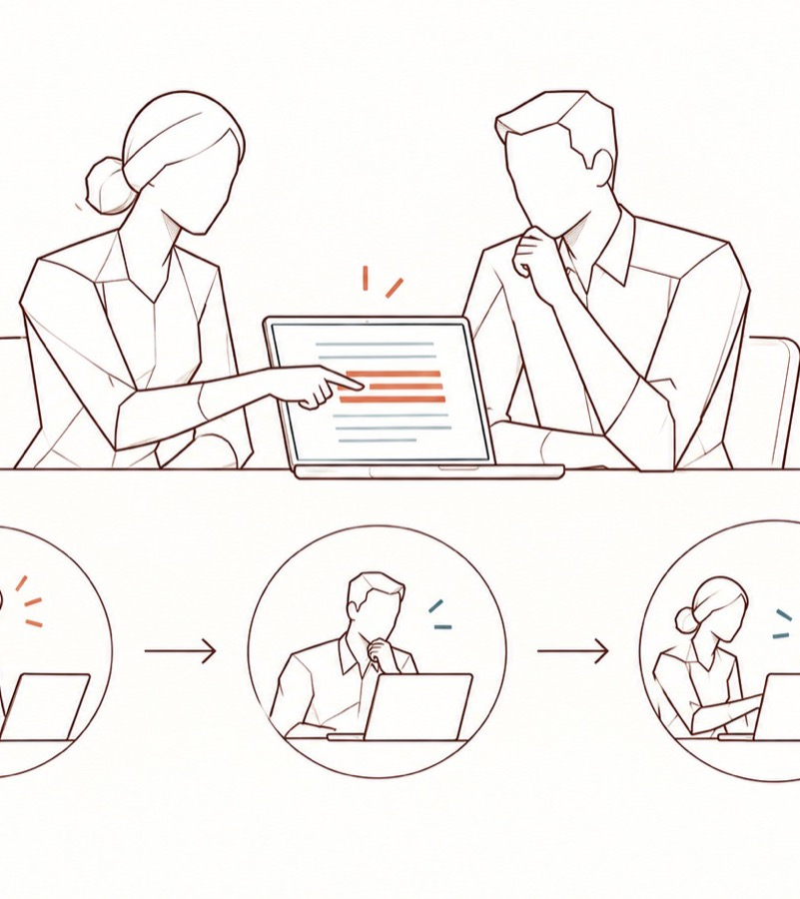
6. Training and help
Training
Everyone follows [the training: format, duration] before using an AI tool for work, then [a refresher every …].
In each team
[the Seals — Seal and Engage Against Leaks — or your own name for the role] relay the reflex and answer questions.
Who they are
[location].
Questions
[contact: address or channel].
[Organisation] · Version [number] of [date] · Owner: [function, e.g. the DPO] · Next review: [date]
Adapted from the example AI charter published by Contee (DoNotLeak) · CC BY-SA 4.0
Notes:
AI Act, article 4: the organisation takes measures to support its staff's AI literacy; no certificate is required.
Picture: an adoption goal to measure, not a teaching gain already proven.

Slide 10
7. Reporting an incident
If something left
that should not have — personal data, a secret, a confidential document — or if you are unsure:
1. Say it at once
to [contact, e.g. the DPO: address, phone], within [hours]. An early report is expected and valued; no one is blamed for reporting.
2. Contain
delete the conversation where the tool allows it, and tell [IT security] at once about any password or key that left, so it is revoked and replaced.
3. [Organisation] assesses
what happened. A personal data breach is notified to the supervisory authority [in France, the CNIL] within 72 hours where feasible, unless it is unlikely to result in a risk to people; every breach is documented (GDPR, article 33).
[Organisation] · Version [number] of [date] · Owner: [function, e.g. the DPO] · Next review: [date]
Adapted from the example AI charter published by Contee (DoNotLeak) · CC BY-SA 4.0
Notes:
A text sent to an AI cannot be recalled: what counts is speed.

Slide 11
8. Measurement, not surveillance
[Organisation] follows this charter through volumes — approved tools, people trained, incidents reported [, detections by type] — never through the content of what anyone writes.
[Describe any logging that exists: its purpose, its retention period and who can read it.]
[Organisation] · Version [number] of [date] · Owner: [function, e.g. the DPO] · Next review: [date]
Adapted from the example AI charter published by Contee (DoNotLeak) · CC BY-SA 4.0

Slide 12
9. Sanctions
[To be written by [Organisation], according to its internal rules and the applicable labour law.]
[Organisation] · Version [number] of [date] · Owner: [function, e.g. the DPO] · Next review: [date]
Adapted from the example AI charter published by Contee (DoNotLeak) · CC BY-SA 4.0

Slide 13
10. Review
[Function] reviews this charter [every year] and after any significant incident,
with [the DPO, IT security, legal, staff representatives]. Proposals: [contact].
[Organisation] · Version [number] of [date] · Owner: [function, e.g. the DPO] · Next review: [date]
Adapted from the example AI charter published by Contee (DoNotLeak) · CC BY-SA 4.0

Slide 14
I have read the charter for the use of AI tools at [Organisation]
Full name
Team
How to use it
I know what is allowed, what must be protected first and whom to call when in doubt or after an incident. This signature records a reading: it discharges [Organisation] of none of its obligations.
In capitals
Department or team
Date
Signature
DD/MM/YYYY
By hand or electronic
[Organisation] · Version [number] of [date] · Owner: [function, e.g. the DPO] · Next review: [date]
Adapted from the example AI charter published by Contee (DoNotLeak) · CC BY-SA 4.0
Notes:
An informed commitment, not a discharge: a signed charter discharges the organisation of nothing. What counts is that people know it when they act.

Slide 15
References
Ref.
CNIL, Q&A on the use of generative AI systems (18 July 2024):
  https://www.cnil.fr/en/cnils-qa-use-generative-ai-systems
GDPR, Regulation (EU) 2016/679 — articles 24, 29, 32 and 33:
  https://eur-lex.europa.eu/eli/reg/2016/679/oj
AI Act, Regulation (EU) 2024/1689 — article 4, AI literacy:
  https://eur-lex.europa.eu/eli/reg/2024/1689/oj,
  as amended by Regulation (EU) 2026/1744: https://eur-lex.europa.eu/eli/reg/2026/1744/oj
[Organisation] · Version [number] of [date] · Owner: [function, e.g. the DPO] · Next review: [date]
Adapted from the example AI charter published by Contee (DoNotLeak) · CC BY-SA 4.0

Slide 16
Licence — keep this notice
Source
Adapted from the example AI charter published by Contee (DoNotLeak, https://donotleak.contee.eu/governance) under the Creative Commons Attribution-ShareAlike 4.0 licence (CC BY-SA 4.0, https://creativecommons.org/licenses/by-sa/4.0/deed.en).
What you may do
You may copy, adapt and share it, for any purpose, crediting Contee.
If you adapt it
ShareAlike: if you publish an adapted version, publish it under the same licence, so that everyone can build on the improvements in turn.
[Organisation] · Version [number] of [date] · Owner: [function, e.g. the DPO] · Next review: [date]
Adapted from the example AI charter published by Contee (DoNotLeak) · CC BY-SA 4.0
Notes:
This notice stays on the last page of any adapted version: it is the condition of the CC BY-SA 4.0 licence.

