Slide 1
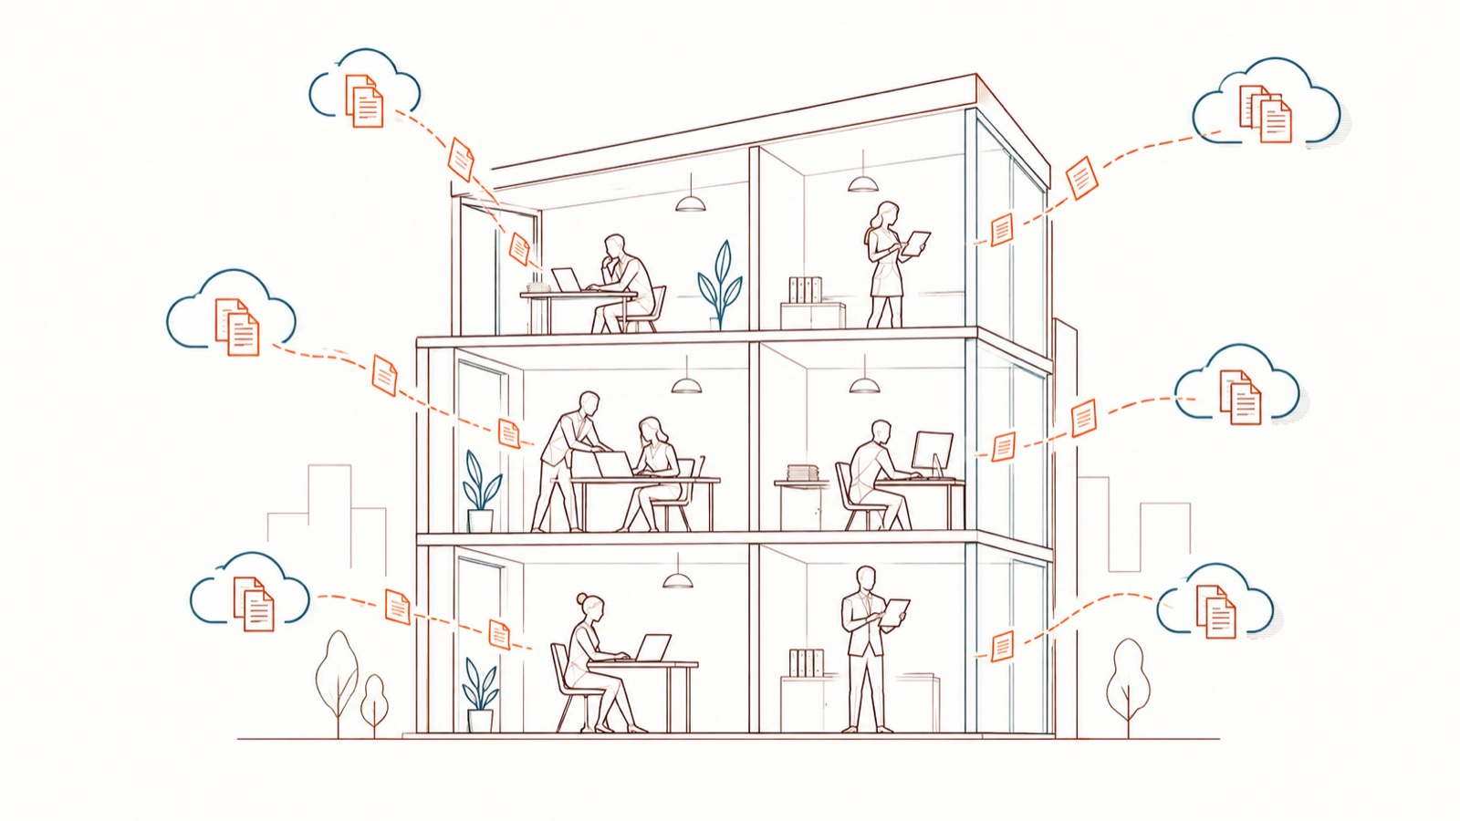
AI at work, without leaks
Awareness webinar · 45 minutes · [Organisation]
DoNotLeak kit · Contee — an example to adapt, not legal advice
Notes:
Welcome (1 min). Say: “AI helps all of us every day. This webinar is not here to ban it: it gives a reflex for using it without letting out what must stay with us.”
Picture: a figurative accumulation — not an estimate of any company’s leaks.

Slide 2
What we will cover
1
What happens, day to day
5 min
2
Where the data goes
10 min
3
Who answers for what
5 min
4
The right reflex, demonstrated
15 min
5
If something has left
5 min
6
Your questions
5 min
DoNotLeak kit · Contee — an example to adapt, not legal advice
Notes:
Announce the two participative moments: the received ideas and the quiz.

Slide 3
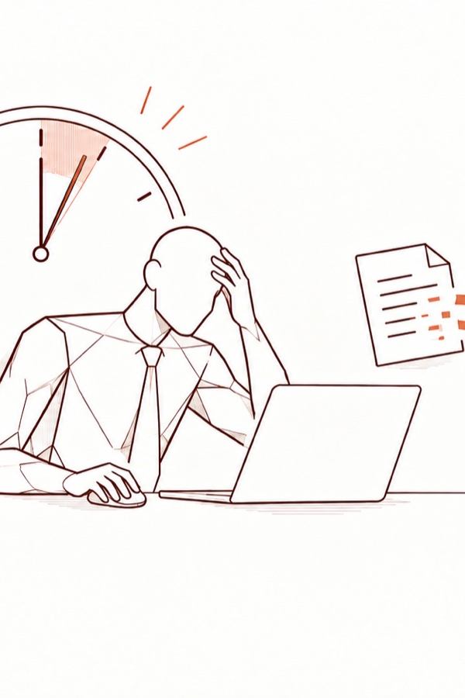
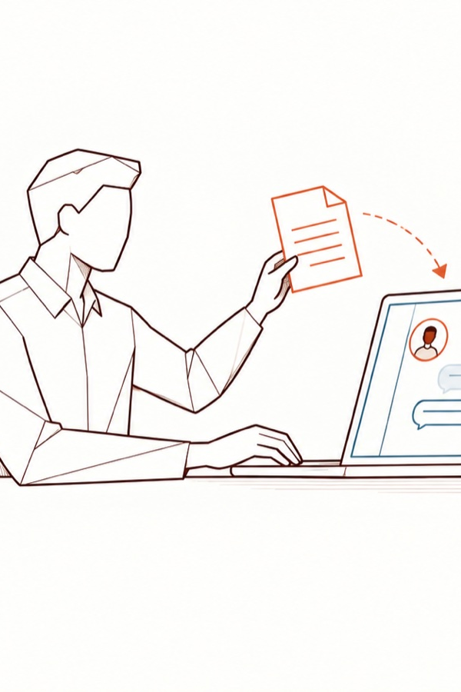
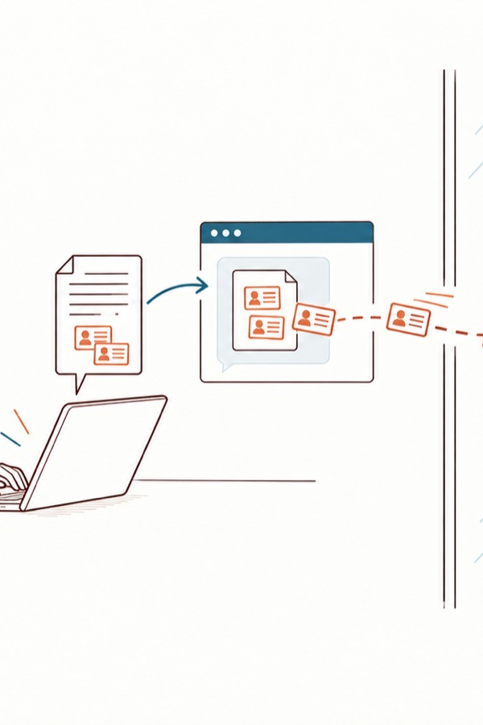
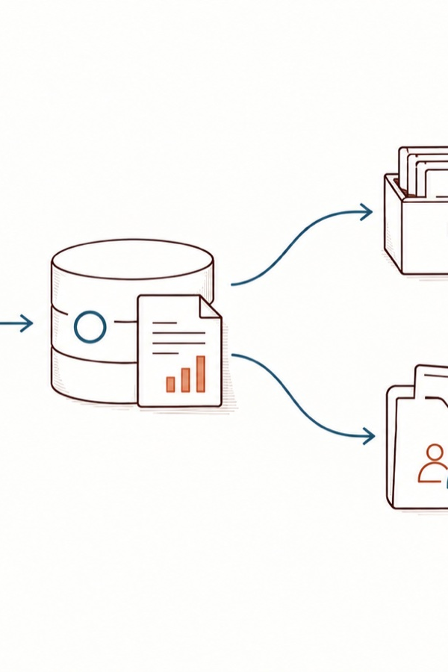
Tuesday, 6 pm: a deadline, a copy and paste
Tuesday, 6 pm. A contract summary due tomorrow.
The approved tool is slow. “I’ll paste it, it’s quicker.”
The whole contract leaves: names, amounts, clauses.
Nobody decided it. Nobody sees it.
DoNotLeak kit · Contee — an example to adapt, not legal advice
Notes:
A fictional scenario. Say: “Nothing malicious here: a deadline, a tool that genuinely helps. The risk is invisible at the moment of the gesture.”
The panels borrow four scenes from the DoNotLeak picture set; a dedicated strip, with one recurring character, has been requested from Contee-Design.
Picture limits: an illustrative scenario, not an observed leak; the scene explains a pressure, it does not blame employees; exposure to a third party does not automatically mean a breach.

Slide 4
Most people bring their own AI tools
78%
of AI users bring their own AI tools to work (Microsoft and LinkedIn, 2024).
= 1 %
DoNotLeak kit · Contee — an example to adapt, not legal advice
Notes:
Source: Microsoft and LinkedIn, Work Trend Index 2024 — 31,000 people surveyed in 31 countries. https://www.microsoft.com/en-us/worklab/work-trend-index/ai-at-work-is-here-now-comes-the-hard-part

Slide 5
And often with a personal account
72%
of employees who routinely use AI on a work device do so with a non-corporate email account (Verizon, 2025).
= 1 %
DoNotLeak kit · Contee — an example to adapt, not legal advice
Notes:
Source: Verizon, Data Breach Investigations Report 2025 — “72% of employees who routinely use AI services on a work device do so with an account tied to a non-corporate email address”. https://www.verizon.com/business/resources/reports/2025-dbir-executive-summary.pdf

Slide 6



Company data, personal accounts
Outside any contract
Outside any log
Outside any policy
No agreement binds the provider to the company: the terms are the ones the employee accepted, for themselves.
The company does not know what left, when, or to which service: it can neither answer for it nor correct it.
Whatever the charter says about what may be shared, it is not there at the moment of the paste.
DoNotLeak kit · Contee — an example to adapt, not legal advice
Notes:
Shadow AI is the use of AI tools the organisation has not chosen. Nobody does it to cause harm.

Slide 7
2 · Where the data goes
DoNotLeak kit · Contee — an example to adapt, not legal advice

Slide 8
After the paste: five steps, not one
Exposure
Retention
Training
Memorisation
Restitution
A free account does not automatically mean training: it all depends on the service, its terms and its settings.
The CNIL recommends turning off the reuse of conversations.
DoNotLeak kit · Contee — an example to adapt, not legal advice
Notes:
Exposure: the text reaches the provider. Retention: history and logs, according to its terms. Training: on some consumer offers, depending on the terms and settings. Memorisation: researchers extracted verbatim training data from a model (Carlini et al., USENIX Security 2021). Restitution: for the EDPB, a model trained on personal data cannot, in all cases, be considered anonymous (opinion 28/2024).
Do not present these steps as a certain chain: each is a possibility to check.
Sources: CNIL, Q&A on generative AI — https://www.cnil.fr/en/cnils-qa-use-generative-ai-systems; Carlini et al. 2021 — https://www.usenix.org/conference/usenixsecurity21/presentation/carlini-extracting; EDPB, opinion 28/2024 — https://www.edpb.europa.eu/our-work-tools/our-documents/opinion-board-art-64/opinion-282024-certain-data-protection-aspects_en

Slide 9
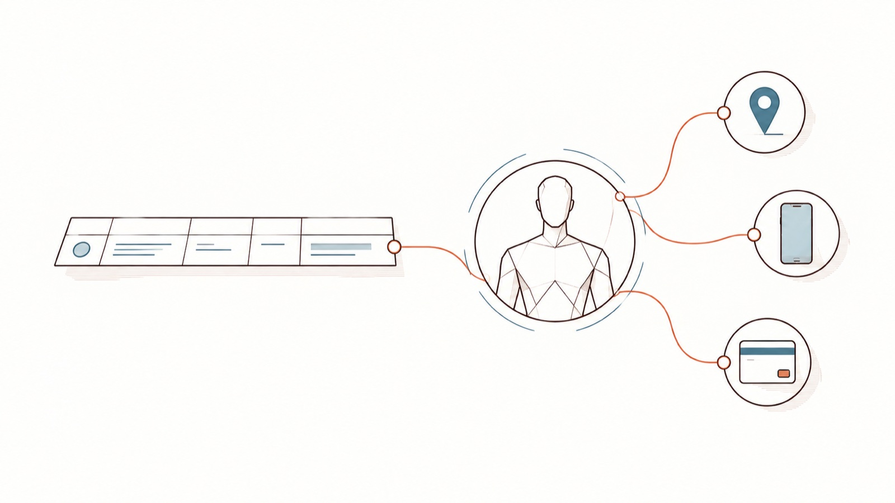
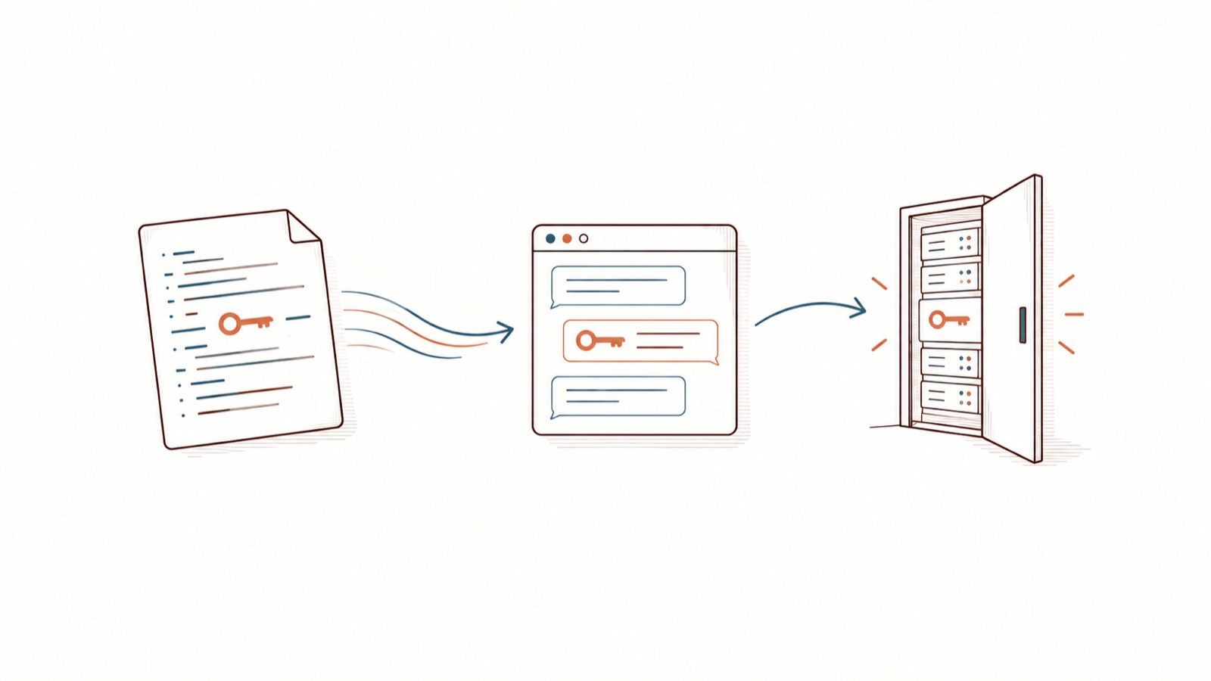
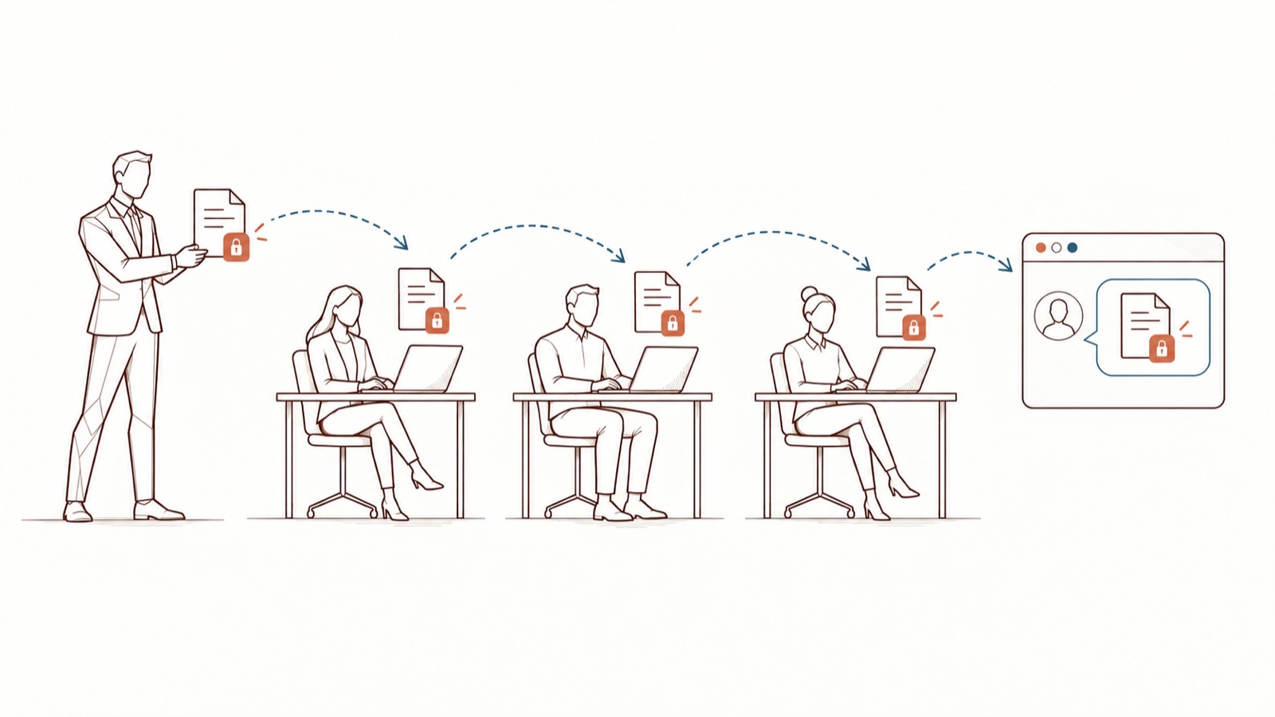
What leaves with the text
People
Access
Commitments
Clients, patients, candidates, colleagues: a pasted text is often about someone.
An API key, a token, a password left in a snippet: whoever reads it can use it.
A tender, a proposal under confidentiality: the confidentiality follows the document.
DoNotLeak kit · Contee — an example to adapt, not legal advice
Notes:
Personal data goes beyond a list of formats: ordinary fields, combined, can identify someone. Whether a given confidentiality clause is breached depends on its wording: a question for the legal team.
Picture limits: no real secret is shown; the contractual scenario is for the legal team to qualify.

Slide 10
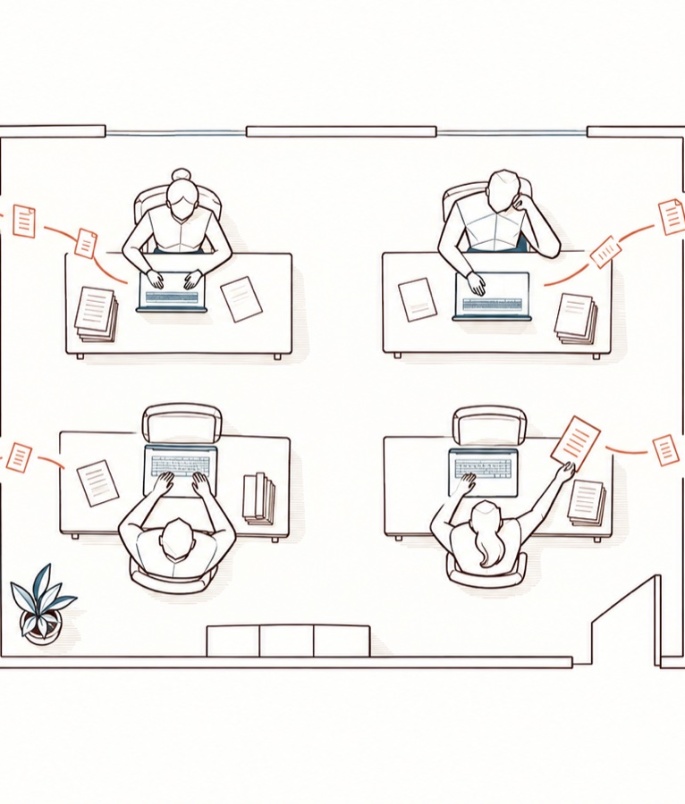
One paste is small. A year of them is not.
Multiply by the working days of a year
Then by the people in a team, then by the teams
Nobody sees it: nobody sends it all at once
Your order of magnitude: the DoNotLeak calculator
DoNotLeak kit · Contee — an example to adapt, not legal advice
Notes:
No figure here: yours depends on your teams and your documents. The calculator (donotleak.contee.eu) starts from your own numbers.
Picture: a symbolic volume, no real measurement or statistical proportion.

Slide 11
3 · Who answers for what
DoNotLeak kit · Contee — an example to adapt, not legal advice

Slide 12




The organisation answers. Everyone acts.
The organisation
The DPO
Each person
AI literacy
Puts appropriate measures in place and must be able to demonstrate them (GDPR, art. 24).
Informs, advises, monitors, trains. Is not personally liable for the organisation’s failings (art. 39).
Processes data only on the organisation’s instructions: the charter writes them down (art. 29, 32.4).
Since February 2025, the organisation supports the AI literacy of its staff (AI Act, art. 4).
DoNotLeak kit · Contee — an example to adapt, not legal advice
Notes:
This is not legal advice: the slide points to the texts; your DPO and your counsel apply them to your situation.
AI Act, article 4: the wording of Regulation (EU) 2026/1744 (the Digital Omnibus on AI), in force since 27 July 2026. No certificate is required.
Sources: GDPR, articles 24, 29, 32, 39 (EUR-Lex); CNIL, becoming a DPO; Regulation (EU) 2024/1689, article 4.

Slide 13
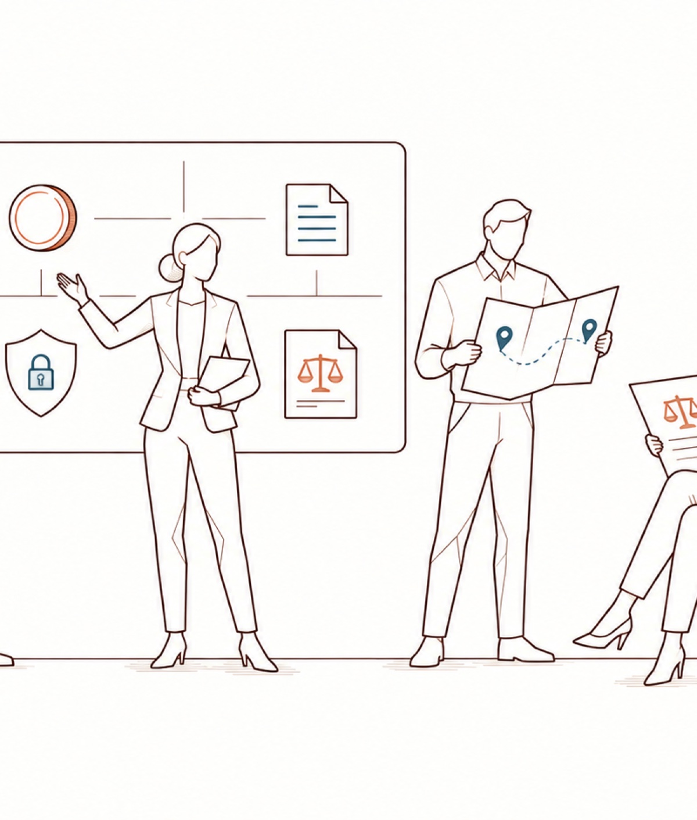
From the sword of Damocles to shared responsibility
Today, the pressure weighs on one person who sees nothing
The frame brings the decision back to the moment of the gesture
You see what would leave, you decide
You remain the author of what you send
The DPO designs the frame and trains
DoNotLeak kit · Contee — an example to adapt, not legal advice
Notes:
What shared responsibility does not mean: it is organisational, it makes no employee a joint controller within the meaning of the GDPR; a signed charter discharges the organisation of nothing; human review is no guarantee, it needs context, time and means.
Picture: operational responsibility, not GDPR joint controllership.

Slide 14
4 · The right reflex, before every prompt
DoNotLeak kit · Contee — an example to adapt, not legal advice

Slide 15




The reflex: four gestures, a few seconds
Paste or drop
See what leaves
Decide
Copy, send
On the page, with no account or installation; a docx, txt or md file up to 10 MB.
Send only the part your question needs.
DoNotLeak kit · Contee — an example to adapt, not legal advice
Notes:
Paste the text (or drop the file); see each detection with its type; keep what the AI needs, replace the rest; copy the protected version and paste it into the approved AI tool.

Slide 16
What you paste, what the AI receives
Before
After
Call with Julie Marchand, purchasing manager at Transports Berthier in Nantes
Quote from julie.marchand@example.org, mobile 06 39 98 41 27
Deposit to FR76 3000 6000 0112 3456 7890 189
Call with [[PERSON-1]], purchasing manager at [[ORGANIZATION-1]] in [[LOCATION-1]]
Quote from [[EMAIL-1]], mobile [[PHONE-1]]
Deposit to [[IBAN-1]]
DoNotLeak kit · Contee — an example to adapt, not legal advice
Notes:
Recorded from the DoNotLeak engine (labels mode), as the Shadow AI page shows it; the details are fictional.
Replacing is pseudonymising, not anonymising: pseudonymised data remains personal data under the GDPR (article 4.5, recital 26).

Slide 17
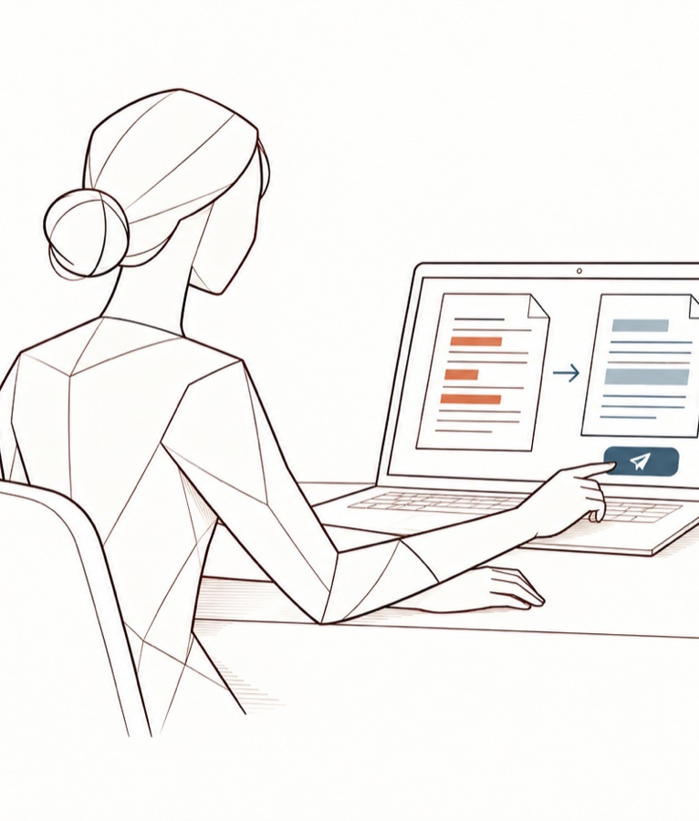
Demonstration: donotleak.contee.eu
On the page, with no account or installation
Each detection shown with its type, before sending
Labels, or plausible replacements
The text is processed in memory, then forgotten
Hosted in France, by OVH
DoNotLeak kit · Contee — an example to adapt, not legal advice
Notes:
Live demonstration (5 min) on a FICTIONAL text — never a real document during a webinar. Show a detection, a value kept, then copying the protected version.
To say honestly: today the text goes, encrypted, to the server for the scan; it is neither stored nor logged there.
Picture: an illustration of the journey, not a screenshot of the interface.

Slide 18
Four received ideas
Received idea
What is true
A free account always means training
It depends on the service, its terms and its settings
The tool finds everything
No detection finds everything: review before you send
No name, no risk
A strategy or a margin can be confidential without a single name
A signed charter protects the company
It discharges the organisation of nothing: people must know it when they act
DoNotLeak kit · Contee — an example to adapt, not legal advice
Notes:
DoNotLeak spots personal data, identifiers and access keys; it does not recognise a secret by its meaning, nor a server name or an architecture note. Reviewing before sending is up to you.

Slide 19
Question 1
Quiz
Who answers for what happens to the personal data processed for work?
A
The person who pasted the text
B
The DPO
C
The organisation, the data controller
DoNotLeak kit · Contee — an example to adapt, not legal advice

Slide 20
Question 1 — the answer
Quiz
Who answers for what happens to the personal data processed for work?
A
The person who pasted the text
B
The DPO
C
The organisation, the data controller
✓
GDPR, article 24: the organisation puts the measures in place and must be able to demonstrate them. The DPO informs, advises and monitors.
DoNotLeak kit · Contee — an example to adapt, not legal advice

Slide 21
Question 2
True or false?
Replacing names with labels makes a text anonymous.
True
False
DoNotLeak kit · Contee — an example to adapt, not legal advice

Slide 22
Question 2 — the answer
True or false?
Replacing names with labels makes a text anonymous.
True
False
✓
It is pseudonymisation: what remains — a job title, a date, a rare event — can still point to someone.
DoNotLeak kit · Contee — an example to adapt, not legal advice
Notes:
Source: CNIL, anonymisation of personal data; GDPR, article 4.5 and recital 26.

Slide 23
5 · If something has left
DoNotLeak kit · Contee — an example to adapt, not legal advice

Slide 24
A path known in advance
Say it at once, without fear
Contain: delete, get keys revoked
The organisation assesses, notifies
Learn: the charter evolves
DoNotLeak kit · Contee — an example to adapt, not legal advice
Notes:
A text sent to an AI cannot be recalled — DoNotLeak cannot do it either: what counts is speed.
1. Tell the contact the charter names; a quick report beats a perfect one, and nobody is blamed for reporting.
2. Delete the conversation when the service allows it; get passwords or keys revoked and replaced.
3. A personal data breach is notified to the supervisory authority — in France, the CNIL — within 72 hours where feasible, unless it is unlikely to result in a risk to people; every breach is documented (GDPR, article 33).
4. What the incident teaches goes back into the charter and the training.

Slide 25
In your team
Your team’s Seal relays the reflex and answers your questions.
Who they are: [location]. A question about the charter: [DPO contact].
DoNotLeak kit · Contee — an example to adapt, not legal advice
Notes:
The Seals: Seal and Engage Against Leaks — in each team, a volunteer who relays the reflex and answers questions.

Slide 26
Seeing what would leave, before sending, puts the decision back in the person’s hands.
DoNotLeak kit · Contee — an example to adapt, not legal advice

Slide 27
Say yes to AI, with a frame that holds.
[DPO contact] · donotleak.contee.eu
1.
Read [Organisation]’s AI charter: [link]
2.
Try DoNotLeak today, on a fictional text
3.
Ask your team’s Seal your questions
DoNotLeak kit · Contee — an example to adapt, not legal advice

Slide 28
Licence — keep this notice
Source
Adapted from the DoNotLeak kit published by Contee (https://donotleak.contee.eu/dpo) under the Creative Commons Attribution-ShareAlike 4.0 licence (CC BY-SA 4.0, https://creativecommons.org/licenses/by-sa/4.0/deed.en).
What you may do
You may copy, adapt and share it, for any purpose, crediting Contee.
If you adapt it
ShareAlike: if you publish an adapted version, publish it under the same licence, so that everyone can benefit from the improvements in turn.
DoNotLeak kit · Contee — an example to adapt, not legal advice
Notes:
This notice stays on the last page of any adapted version: it is the condition of the CC BY-SA 4.0 licence. An example to adapt, not legal advice.

