Slide 1
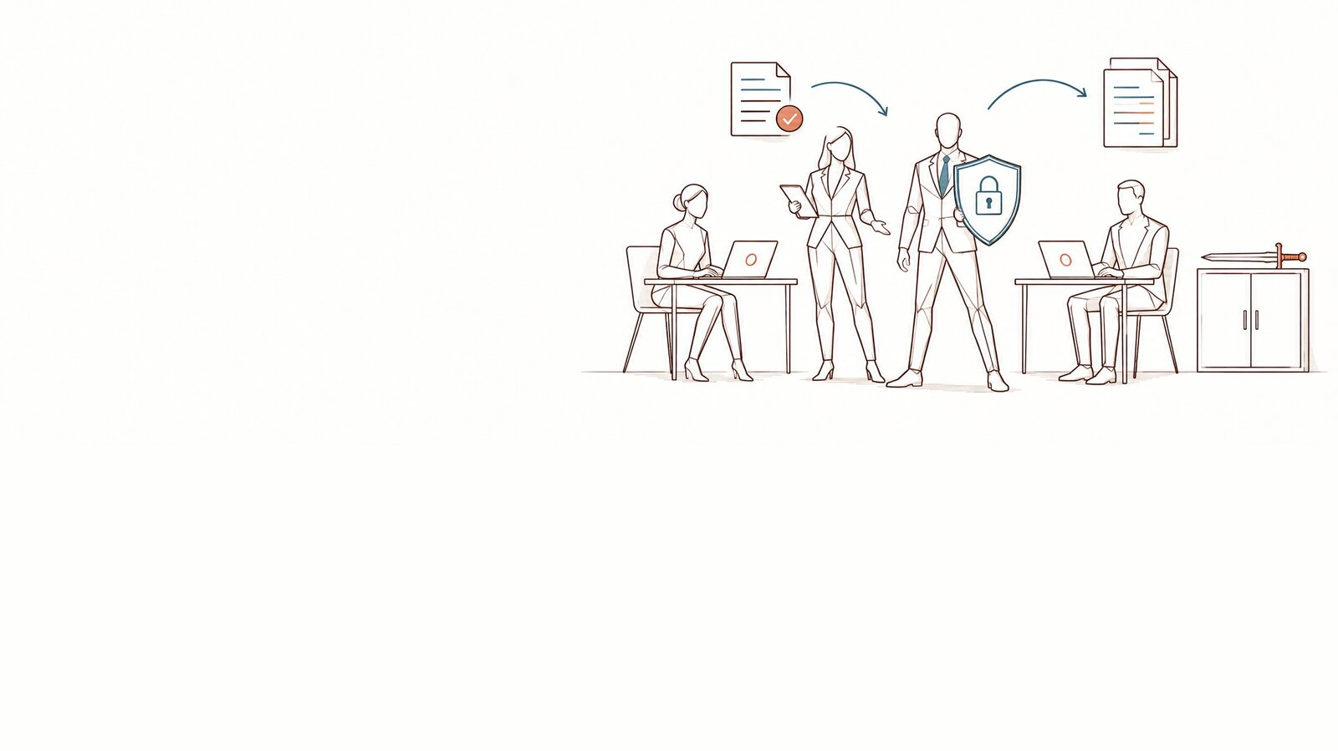
The DPO’s 90-day plan
Decide, frame, launch, train, animate, measure, react · [Organisation]
DoNotLeak kit · Contee — an example to adapt, not legal advice
Notes:
The plan that ties every item of the kit together: three thirty-day phases, seven streams, who does what, the governance bodies, the communication, the launch checklist and the measurement. Replace every field in [brackets].
Picture: the panorama “a frame gives room to breathe” from the DoNotLeak picture set, until the scene requested from Contee-Design arrives (D-1: a DPO opens a case; colleagues each take one item from it). The picture’s limit: the metaphor does not announce that the risk disappears.

Slide 2
Three thirty-day phases, and what each delivers
Decide, frame: D1-30
Launch, train: D31-60
Animate, measure: D61-90
The committee’s decision, a sponsor
The charter adapted, the works council told
The register, the DPIA, the questionnaire
The incident contact published
The announcement by management
The 45-minute webinar for everyone
The Seals recruited and trained
The managers trained
The Seals’ monthly meeting
Demos in the teams
Volumes tracked, never people
The review at the executive committee
DoNotLeak kit · Contee — an example to adapt, not legal advice
Notes:
Every deliverable has its template in the kit: the note and the deck for the executive committee, the charter, the works-council note, the templates to copy (emails, register, DPIA, security questionnaire, incident), the webinar, the Seals training.

Slide 3
Seven streams over six fortnights
D1-15
D16-30
D31-45
D46-60
D61-75
D76-90
Decide — note and committee
Frame — charter, council, register
Launch — announcement, webinar
Train — all, managers, Seals
Animate — the Seals’ rituals
Measure — volumes
React — the incident path
DoNotLeak kit · Contee — an example to adapt, not legal advice
Notes:
Decide: days 1 to 15; frame: 1 to 30; launch: 31 to 45; train: 31 to 75; animate: 46 to 90; measure: 61 to 90; react: at any time, from day one.

Slide 4
Who does what — an example to adapt
Stream | Executive committee | DPO | IT / CISO | HR | Managers | Seals
AI charter | A | R | C | C | I | I
Protection tool | A | C | R | I | I | I
Training | I | R | C | A | C | C
The Seals | I | A/R | I | C | C | R
Measurement | I | A | R | I | I | C
Incident | A | R | R | I | I | C
R
Responsible
A
Accountable
C
Consulted
I
Informed
DoNotLeak kit · Contee — an example to adapt, not legal advice
Notes:
An example: each organisation assigns its own roles, with a single A per row. Incident: the organisation, as controller, answers for the notification (GDPR, art. 33); the DPO advises and coordinates (art. 39).

Slide 5
The governance bodies: who decides, how often
Body | Members | Cadence | Mandate | Escalates to
AI and data committee | DPO, IT / CISO, legal, HR, two managers, one Seal | Monthly | Keeps the list of approved tools, settles exceptions, follows the volumes | Executive committee
Executive committee | General management, the sponsor; the DPO invited | Quarterly | Approves the charter and its revisions, decides the resources
Seals’ meeting | The Seals, the DPO | Monthly | Shares questions and lessons, prepares the demos | AI and data committee
DoNotLeak kit · Contee — an example to adapt, not legal advice
Notes:
The AI and data committee settles exceptions: a tool someone asks for, a use the charter does not cover. What it cannot settle goes up to the executive committee.

Slide 6
Who hears what, through which channel, how often
Audience | Message | Channel | Cadence | Owner
Executive committee | The decision, then the volumes | Committee | Quarterly | DPO
Managers | The frame, the Seals’ time | Managers’ meeting | At launch, then monthly | DPO and HR
All staff | The charter, the tool, the reflex | Email, webinar, intranet | At launch, then reminders | Management and DPO
Seals | The rituals, the questions | Meeting, own channel | Monthly | DPO
Works council | The tool, the charter, the measurement | Works-council meeting | Before launch, review at 90 days | DPO and HR
DoNotLeak kit · Contee — an example to adapt, not legal advice
Notes:
The texts of the announcement emails are in “Templates to copy”; the works-council note and its four slides are in the kit.

Slide 7
The Seals’ rituals, over the quarter
Seals’ meeting
once a month
Seals’ newsletter
once a month
Quarterly challenge
launched, then its results
Team demo
every week, one team
D1
D30
D60
D90
Size ∝ the time it takes
DoNotLeak kit · Contee — an example to adapt, not legal advice
Notes:
The rituals start after the Seals are trained (days 31 to 45). The rhythm is an example: adapt it to the size of your teams.

Slide 8
Ready to launch?
The charter approved by the executive committee
The works council informed, and consulted where required
The record of processing updated
Sponsor
DPO and HR
DPO
✓
✕
✓
✕
✓
✕
The webinar scheduled for all staff
The Seals recruited, their time granted
The incident contact published
DPO
Managers
DPO
✓
✕
✓
✕
✓
✕
DoNotLeak kit · Contee — an example to adapt, not legal advice
Notes:
To tick before the announcement to all staff (day 31): each line has its template in the kit.

Slide 9




Measure: volumes, never people
Approved tools
People trained
Incidents reported
Detections by type
How many AI tools are on the list, and how many requests to add one were reviewed.
The share of staff trained, team by team, and the Seals trained.
How many, of what kind, how fast they were handled — with no names.
Coming, once DoNotLeak runs inside: detections by data type, never the content.
DoNotLeak kit · Contee — an example to adapt, not legal advice
Notes:
No one is watched; what people write is not read. DoNotLeak’s counts inside the organisation, by data type, are announced as “soon” on the Governance page: they do not exist yet.

Slide 10
Say yes to AI, with a frame that holds.
[DPO’s name] · [address]
1.
Present the note to the executive committee: [date]
2.
Adapt the charter with your counsel
3.
Recruit the first Seals
DoNotLeak kit · Contee — an example to adapt, not legal advice

Slide 11
Licence — keep this notice
Source
Adapted from the DoNotLeak kit published by Contee (https://donotleak.contee.eu/dpo) under the Creative Commons Attribution-ShareAlike 4.0 licence (CC BY-SA 4.0, https://creativecommons.org/licenses/by-sa/4.0/deed.en).
What you may do
You may copy, adapt and share it, for any purpose, crediting Contee.
If you adapt it
ShareAlike: if you publish an adapted version, publish it under the same licence, so that everyone can benefit from the improvements in turn.
DoNotLeak kit · Contee — an example to adapt, not legal advice
Notes:
This notice stays on the last page of any adapted version: it is the condition of the CC BY-SA 4.0 licence. An example to adapt, not legal advice.

