Slide 1
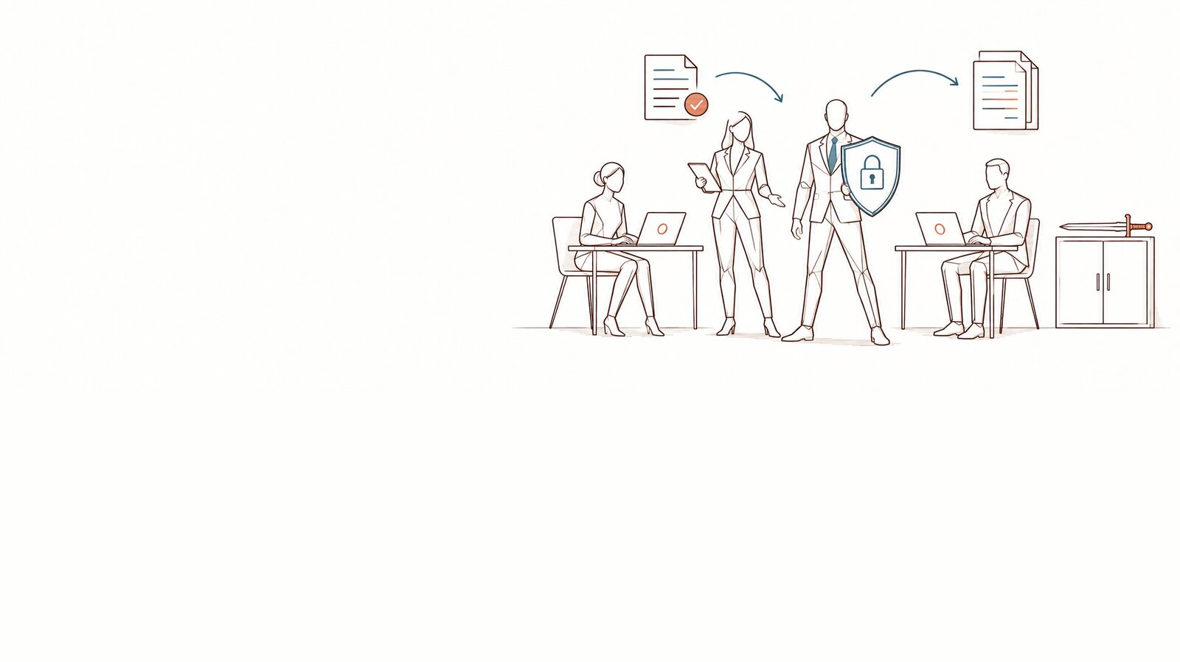
AI and our data — the risks and the plan
Executive committee · 15 minutes and a decision · [Organisation] · [date]
DoNotLeak kit · Contee — an example to adapt, not legal advice
Notes:
Presented by [the DPO], fifteen minutes, with a decision asked for at the end. The one-page note (slide 2) goes out before the meeting as a pre-read; the full note is a separate document in the kit.
Picture: the panorama “a frame gives room to breathe” from the DoNotLeak picture set, until the scene requested from Contee-Design arrives (C-1: a DPO presents a one-page, three-phase plan to an attentive committee). The picture’s limit: the metaphor does not announce that the risk disappears.

Slide 2
The note: AI and our data, on one page
Situation
Our teams use AI to draft, summarise, translate and code, and some of it goes through personal accounts: 78% of AI users bring their own AI tools to work (Microsoft and LinkedIn, 2024); 72% of employees who use AI on a work device do so with a non-corporate account (Verizon, 2025). At [Organisation]: [what you know of the uses].
The risk
What is pasted leaves outside any contract, any log and any policy: data about clients and staff, access keys, documents received in confidence, our know-how. Nobody decides it; nobody sees it.
What the texts say
The organisation answers for its processing and must be able to demonstrate it (GDPR, art. 24); a provider processing data for it is bound by a contract (art. 28); a breach is documented and notified to the supervisory authority within 72 hours where feasible, unless it is unlikely to result in a risk (art. 33). Since February 2025, the organisation takes measures for its staff’s AI literacy (AI Act, art. 4).
The 90-day plan
A five-part frame: a charter, a tool at hand that shows what would leave before sending, training with Seals in the teams, measurement by volumes, a path to follow when something leaves. Three phases: decide and frame, launch and train, run and measure.
The decision requested
Approve the AI charter, name a sponsor on the executive committee, start the 90 days on [date]. Owner: [name, role].
DoNotLeak kit · Contee — an example to adapt, not legal advice
Notes:
To send on its own, as a PDF, before the meeting; the full two-page note is in the kit.
Sources: Microsoft and LinkedIn, Work Trend Index 2024 — https://www.microsoft.com/en-us/worklab/work-trend-index/ai-at-work-is-here-now-comes-the-hard-part ; Verizon, Data Breach Investigations Report 2025 — https://www.verizon.com/business/resources/reports/2025-dbir-executive-summary.pdf ; GDPR, articles 24, 28 and 33 — https://eur-lex.europa.eu/eli/reg/2016/679/oj ; AI Act, article 4 — https://eur-lex.europa.eu/eli/reg/2024/1689/oj, as amended by Regulation (EU) 2026/1744 — https://eur-lex.europa.eu/eli/reg/2026/1744/oj.

Slide 3
What we found, what we propose
Situation
Findings
Recommendation
78% of AI users bring their own tools (2024)
72% of employees using it at work: a non-corporate account (2025)
Here: [what you know of the uses]
Outside any contract, any log, any policy
The organisation answers for it (GDPR, art. 24)
AI literacy required since February 2025 (AI Act, art. 4)
A five-part frame, in 90 days
A tool that shows what would leave, before sending
Volumes measured, never people
DoNotLeak kit · Contee — an example to adapt, not legal advice
Notes:
Sources: Microsoft and LinkedIn, Work Trend Index 2024 (31,000 people, 31 countries); Verizon, DBIR 2025; GDPR, article 24; AI Act, article 4 (as worded by Regulation (EU) 2026/1744, in force since 27 July 2026; no certificate is required).

Slide 4
Most bring their own AI tools
78%
of AI users bring their own AI tools to work (Microsoft and LinkedIn, 2024).
= 1 %
DoNotLeak kit · Contee — an example to adapt, not legal advice
Notes:
Source: Microsoft and LinkedIn, Work Trend Index 2024 — 31,000 people surveyed in 31 countries. https://www.microsoft.com/en-us/worklab/work-trend-index/ai-at-work-is-here-now-comes-the-hard-part

Slide 5
After the paste: five steps, not one
Exposure
Retention
Training
Memorisation
Restitution
A free account does not automatically mean training: it all depends on the service, its terms and its settings.
Only the first step is certain: the text has left.
DoNotLeak kit · Contee — an example to adapt, not legal advice
Notes:
Exposure: the text reaches the provider. Retention: history and logs, as its terms say. Training: on some consumer offers, depending on the terms and the settings; the CNIL recommends turning that reuse off. Memorisation: researchers extracted verbatim training data from a model (Carlini et al., USENIX Security 2021). Restitution: the EDPB holds that a model trained on personal data cannot, in all cases, be considered anonymous (opinion 28/2024).
Sources: CNIL — https://www.cnil.fr/en/cnils-qa-use-generative-ai-systems ; Carlini et al. — https://www.usenix.org/conference/usenixsecurity21/presentation/carlini-extracting ; EDPB — https://www.edpb.europa.eu/our-work-tools/our-documents/opinion-board-art-64/opinion-282024-certain-data-protection-aspects_en

Slide 6
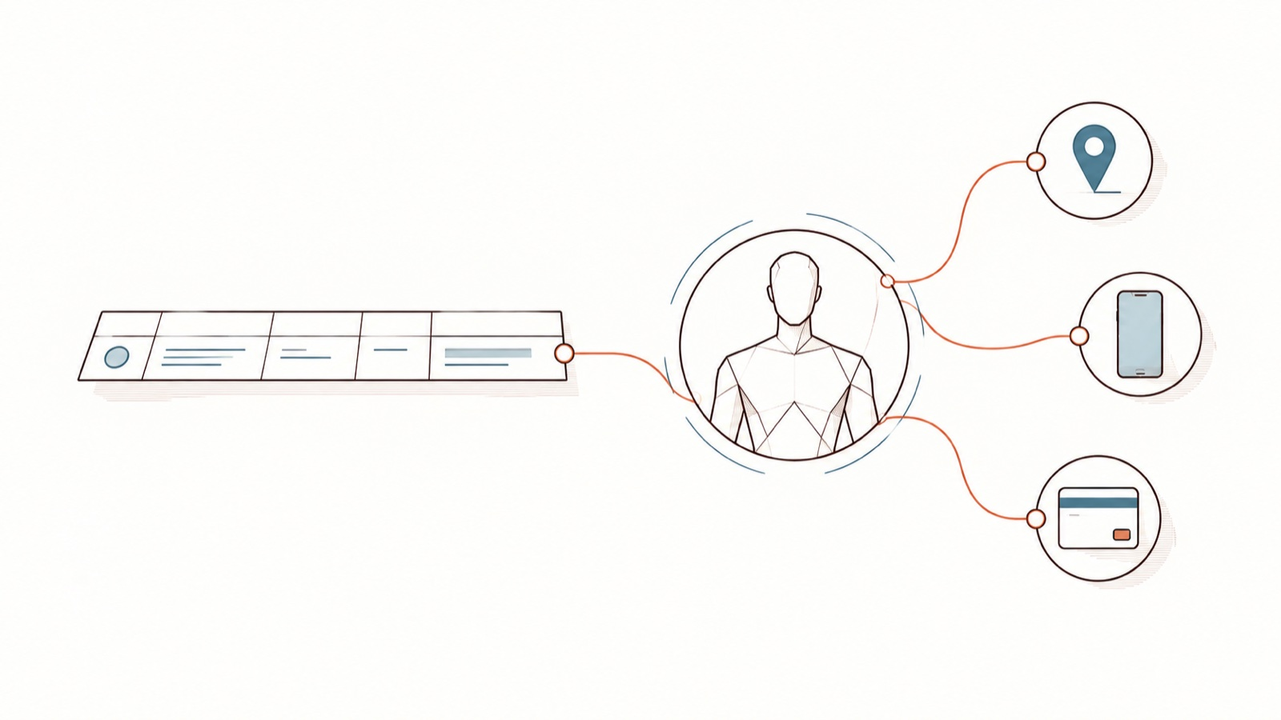
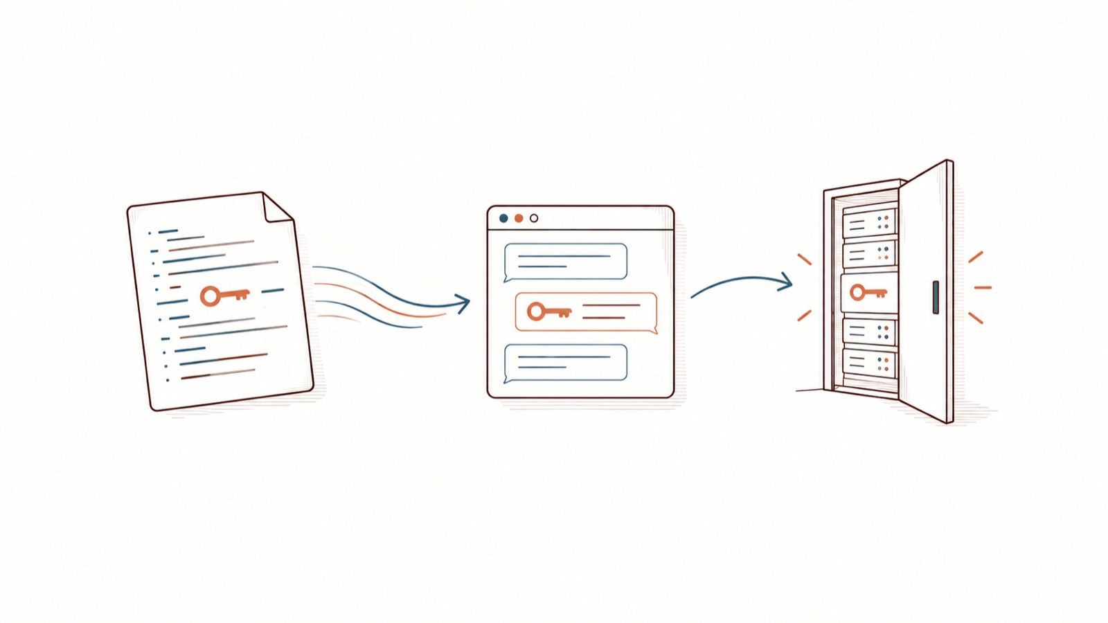
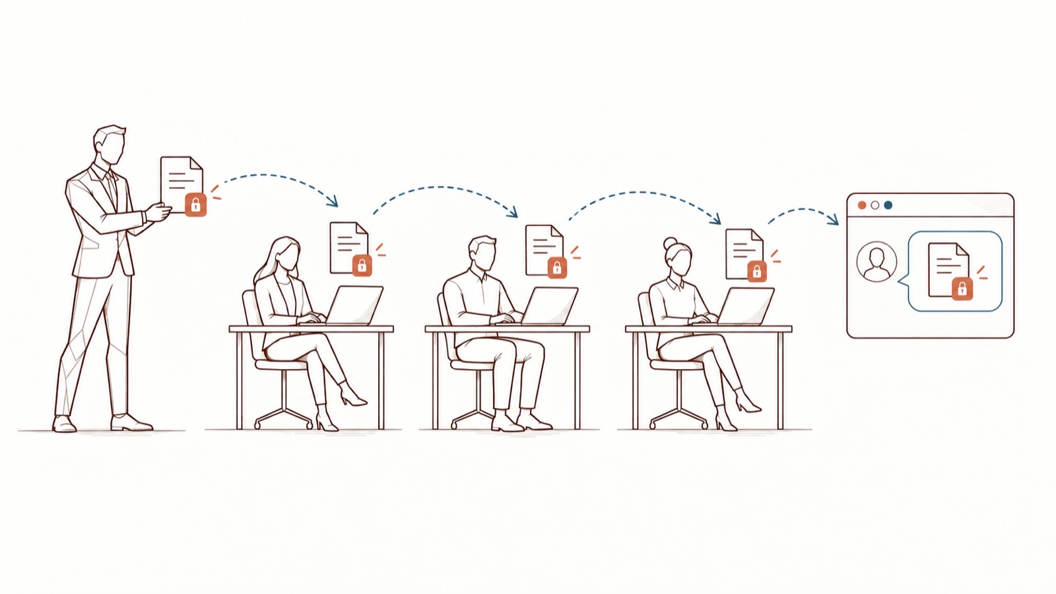
What leaves with the text
People
Access
Commitments
Clients, patients, candidates, colleagues: a pasted text is often about someone.
An API key, a token, a password left in a snippet: whoever reads it can use it.
A tender, a proposal under confidentiality: the confidentiality follows the document.
DoNotLeak kit · Contee — an example to adapt, not legal advice
Notes:
Whether a given confidentiality clause is breached depends on its wording: a question for the legal team. A strategy or a margin can be confidential without a single piece of personal data.
The pictures’ limits: personal data goes beyond a list of detectable formats; a risk scenario, no real secret is shown; a contract scenario to qualify with the legal team, no automatic reading of the NDA.

Slide 7
The risk register, for [Organisation] to assess
Risk | Example | Text | Owner | Likelihood | Impact
Personal data exposed | A client file pasted | GDPR, art. 5, 24, 28 | DPO | [to assess] | [to assess]
Transfer outside the EU | A service run outside the EU | GDPR, chapter V | DPO | [to assess] | [to assess]
Credential exposed | An API key pasted | GDPR, art. 32 | IT / CISO | [to assess] | [to assess]
Confidentiality breached | A tender under NDA | The signed agreement | Legal | [to assess] | [to assess]
Know-how exposed | A price grid, source code | Directive (EU) 2016/943 | Management | [to assess] | [to assess]
AI literacy | Nobody is trained | AI Act, art. 4 | HR and DPO | [to assess] | [to assess]
Breach left unhandled | An incident kept quiet | GDPR, art. 33 and 34 | DPO | [to assess] | [to assess]
DoNotLeak kit · Contee — an example to adapt, not legal advice
Notes:
Likelihood and impact are for [Organisation] to assess, from its own uses and data: this kit gives no value for them. The organisation answers for every line; the “Owner” column suggests who follows it.
Texts: GDPR, articles 5, 24, 28, 32, 33, 34 and chapter V — https://eur-lex.europa.eu/eli/reg/2016/679/oj ; Directive (EU) 2016/943 on trade secrets, article 2 — https://eur-lex.europa.eu/legal-content/EN/TXT/?uri=CELEX:32016L0943 ; AI Act, article 4 — https://eur-lex.europa.eu/eli/reg/2024/1689/oj.

Slide 8
From a risk nobody sees to a frame that holds
Before
After
Bans that get bypassed
The DPO alone, not seeing the uses
No trace of what leaves
A charter known at the moment of acting
The tool at hand, before sending
Seals in the teams
Volumes measured, never people
DoNotLeak kit · Contee — an example to adapt, not legal advice
Notes:
A ban without a practicable path invites detours; what holds is a frame people understand and a tool within everyone’s reach — which is also what the CNIL recommends: choose the tools, say what may be shared, train the people who use them.

Slide 9
90 days, three phases
Decide, frame: D1-30
Launch, train: D31-60
Animate, measure: D61-90
The decision, a sponsor named
The charter adapted, the works council informed
The register and the questionnaire updated
The announcement by management
The 45-minute webinar for everyone
The Seals trained
The Seals’ rituals in the teams
Volumes: tools, training, incidents
The review at the executive committee
DoNotLeak kit · Contee — an example to adapt, not legal advice
Notes:
The detail, stream by stream, is in the kit’s “The DPO’s 90-day plan” deck.

Slide 10
Who does what — an example to adapt
Stream | Executive committee | DPO | IT / CISO | HR | Managers | Seals
AI charter | A | R | C | C | I | I
Protection tool | A | C | R | I | I | I
Training | I | R | C | A | C | C
The Seals | I | A/R | I | C | C | R
Measurement | I | A | R | I | I | C
Incident | A | R | R | I | I | C
R
Does it
A
Answers for it
C
Consulted
I
Informed
DoNotLeak kit · Contee — an example to adapt, not legal advice
Notes:
An example: each organisation shares its roles out, with a single A per row. Incident: the organisation, as controller, answers for the notification (GDPR, art. 33); the DPO advises and coordinates (art. 39).

Slide 11
Your order of magnitude
[number] sensitive items may leave [Organisation] every year — [number] from a single department.
With the DoNotLeak calculator: [headcount] people, [n] documents a day, [x]% sensitive, [n] items per document.
DoNotLeak kit · Contee — an example to adapt, not legal advice
Notes:
Fill it in with the calculator (donotleak.contee.eu/calculator): five figures you know, computed in your browser — nothing you type is sent. The calculation counts 220 working days a year. These are occurrences, not distinct people: the same client counts again in every document that names them. This kit gives no figure in your place.

Slide 12
The decision requested
AI uses that nobody sees or traces
The organisation answers for its data (GDPR, art. 24)
Ban it
Let it be
★ A frame and a tool
Simple to announce; the use moves to personal accounts, with no trace.
Nothing to commit today; the risk stays whole, and invisible.
Charter, tool at hand, training, measurement, incident path: 90 days.
Decision requested: Approve the charter, name a sponsor and start the 90 days
Resolution: The committee approves the AI charter and names [sponsor]. · Owner: [name, role] · Deadline: [date]
DoNotLeak kit · Contee — an example to adapt, not legal advice
Notes:
Banning without offering a practicable path can encourage detours: blocking changes nothing, people work around it. The frame brings the decision back to the moment of the gesture.

Slide 13
Say yes to AI, with a frame that holds.
[DPO’s name] · [address] · next committee: [date]
1.
Read [Organisation]’s AI charter: [link]
2.
Name the sponsor and the IT representative
3.
First progress review at the committee: [date]
DoNotLeak kit · Contee — an example to adapt, not legal advice

Slide 14
Licence — keep this notice
Source
Adapted from the DoNotLeak kit published by Contee (https://donotleak.contee.eu/dpo) under the Creative Commons Attribution-ShareAlike 4.0 licence (CC BY-SA 4.0, https://creativecommons.org/licenses/by-sa/4.0/deed.en).
What you may do
You may copy, adapt and share it, for any purpose, crediting Contee.
If you adapt it
ShareAlike: if you publish an adapted version, publish it under the same licence, so that everyone can benefit from the improvements in turn.
DoNotLeak kit · Contee — an example to adapt, not legal advice
Notes:
This notice stays on the last page of any adapted version: it is the condition of the CC BY-SA 4.0 licence. An example to adapt, not legal advice.

