Slide 1
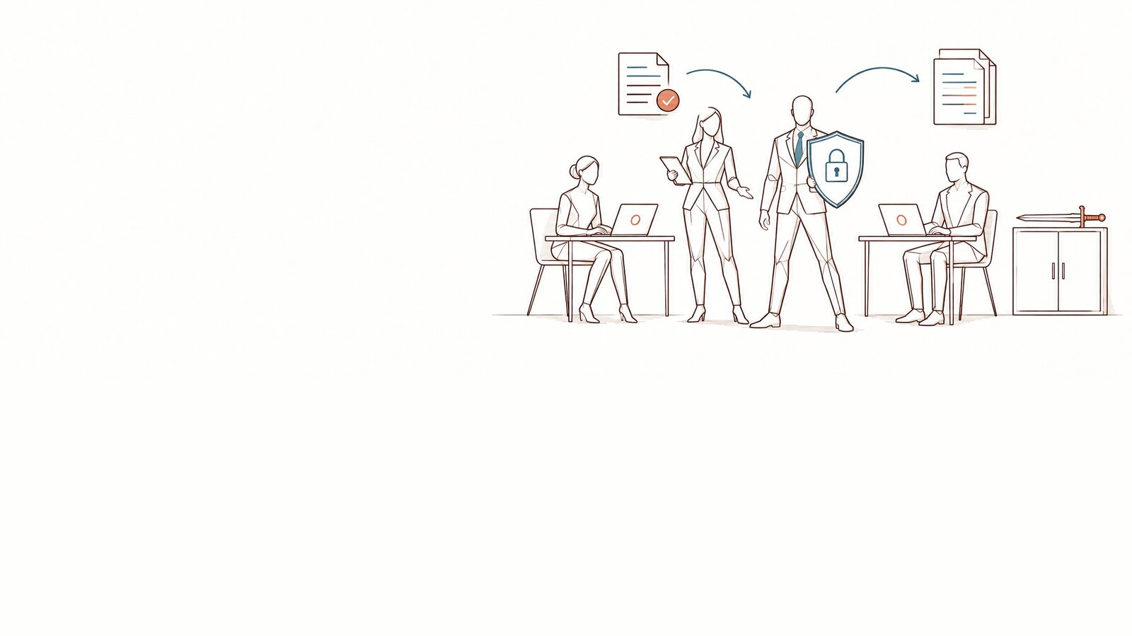
Note to the executive committee — AI and our data
Pre-read · [Organisation] · [date] · [author, role]
DoNotLeak kit · Contee — an example to adapt, not legal advice
Notes:
The note to send before the meeting, as a PDF (File › Export): a few pages to read, then the kit’s fifteen-minute deck “AI and our data — the risks and the plan”. Replace every field in [brackets].
Picture: the panorama “a frame gives room to breathe” from the DoNotLeak picture set, until the scene requested from Contee-Design arrives (C-1). The picture’s limit: the metaphor does not announce that the risk disappears.

Slide 2
AI and our data — the note (1/3)
Purpose
Decide how [Organisation] frames its staff’s use of AI tools: a charter, a tool at hand, training, measurement and a path to follow when something leaves, in 90 days.
Situation
Our teams use AI to draft, summarise, translate and code. Two international surveys measure the trend: 78% of AI users bring their own AI tools to work (Microsoft and LinkedIn, Work Trend Index 2024, 31,000 people in 31 countries); 72% of the employees who routinely use AI on a work device do so with an account tied to a non-corporate email (Verizon, Data Breach Investigations Report 2025). At [Organisation]: [validated tools, known or suspected uses, teams concerned].
The risk
A text pasted into a personal account leaves outside any contract, any log and any policy. It may carry data about clients, patients, candidates or staff; an access key left in a snippet; a document received in confidence; our know-how. What the provider does with it depends on the service, its terms and its settings: retention, sometimes training. Nobody decides it, nobody sees it — and one paste multiplied by a year and by our teams is no longer a detail.
DoNotLeak kit · Contee — an example to adapt, not legal advice
Notes:
Sources: Microsoft and LinkedIn, Work Trend Index 2024 — https://www.microsoft.com/en-us/worklab/work-trend-index/ai-at-work-is-here-now-comes-the-hard-part ; Verizon, DBIR 2025 — https://www.verizon.com/business/resources/reports/2025-dbir-executive-summary.pdf ; CNIL, Q&A on generative AI — https://www.cnil.fr/en/cnils-qa-use-generative-ai-systems ; GDPR — https://eur-lex.europa.eu/eli/reg/2016/679/oj ; AI Act, article 4 — https://eur-lex.europa.eu/eli/reg/2024/1689/oj, as worded by Regulation (EU) 2026/1744 — https://eur-lex.europa.eu/eli/reg/2026/1744/oj.

Slide 3
AI and our data — the note (2/3)
What the texts say
The organisation, as controller, puts appropriate measures in place and must be able to demonstrate them (GDPR, art. 24); each person processes the data only on its instructions (art. 29 and 32.4); a provider processing data for it is bound by a contract (art. 28); a breach is documented and notified to the supervisory authority — in France, the CNIL — within 72 hours where feasible, unless it is unlikely to result in a risk (art. 33). Since 2 February 2025, an organisation using AI systems takes measures for its staff’s AI literacy (AI Act, art. 4); no certificate is required. The DPO informs, advises and monitors; the DPO is not personally liable for the organisation’s failings (art. 39).
What we propose
Say yes to AI, with a five-part frame: a short charter, known at the moment of acting; a tool at hand that shows, before sending, what would leave and replaces it — [DoNotLeak: on its page, with no account, or on our own servers]; training for everyone and Seals, volunteers, in the teams; measurement by volumes — validated tools, people trained, incidents reported — never by the content of what anyone writes; a path to follow when something leaves, known in advance.
The 90-day plan
Days 1 to 30: decide, adapt the charter, inform the works council where required, update the register. Days 31 to 60: announce, train all staff (a 45-minute webinar) and the Seals. Days 61 to 90: run the community, measure, review at the committee.
DoNotLeak kit · Contee — an example to adapt, not legal advice
Notes:
Sources: Microsoft and LinkedIn, Work Trend Index 2024 — https://www.microsoft.com/en-us/worklab/work-trend-index/ai-at-work-is-here-now-comes-the-hard-part ; Verizon, DBIR 2025 — https://www.verizon.com/business/resources/reports/2025-dbir-executive-summary.pdf ; CNIL, Q&A on generative AI — https://www.cnil.fr/en/cnils-qa-use-generative-ai-systems ; GDPR — https://eur-lex.europa.eu/eli/reg/2016/679/oj ; AI Act, article 4 — https://eur-lex.europa.eu/eli/reg/2024/1689/oj, as worded by Regulation (EU) 2026/1744 — https://eur-lex.europa.eu/eli/reg/2026/1744/oj.

Slide 4
AI and our data — the note (3/3)
The options
Ban it: simple to announce, but the use moves to personal accounts, with no trace. Let it be: nothing to commit today, the risk stays whole and invisible. A frame and a tool (recommended): AI stays allowed, and the decision returns to the person, at the moment of acting.
What it takes
A sponsor on the executive committee; [x hours a month] for each Seal, granted by their manager; the time of the DPO, IT and HR as the proposed split of roles says; [means to specify].
The decision requested
Approve the AI charter; name [sponsor]; start the 90-day plan on [date]. Owner: [name, role]. Appendices: the deck, the charter, the order of magnitude the DoNotLeak calculator gives with our own figures.
DoNotLeak kit · Contee — an example to adapt, not legal advice
Notes:
The split of roles (who does what) and the three phases are detailed in the committee deck and in the DPO’s 90-day plan. The order of magnitude: donotleak.contee.eu/calculator, computed in your browser, nothing is sent.

Slide 5
Licence — keep this notice
Source
Adapted from the DoNotLeak kit published by Contee (https://donotleak.contee.eu/dpo) under the Creative Commons Attribution-ShareAlike 4.0 licence (CC BY-SA 4.0, https://creativecommons.org/licenses/by-sa/4.0/deed.en).
What you may do
You may copy, adapt and share it, for any purpose, crediting Contee.
If you adapt it
ShareAlike: if you publish an adapted version, publish it under the same licence, so that everyone can benefit from the improvements in turn.
DoNotLeak kit · Contee — an example to adapt, not legal advice
Notes:
This notice stays on the last page of any adapted version: it is the condition of the CC BY-SA 4.0 licence. An example to adapt, not legal advice.

