Slide 1
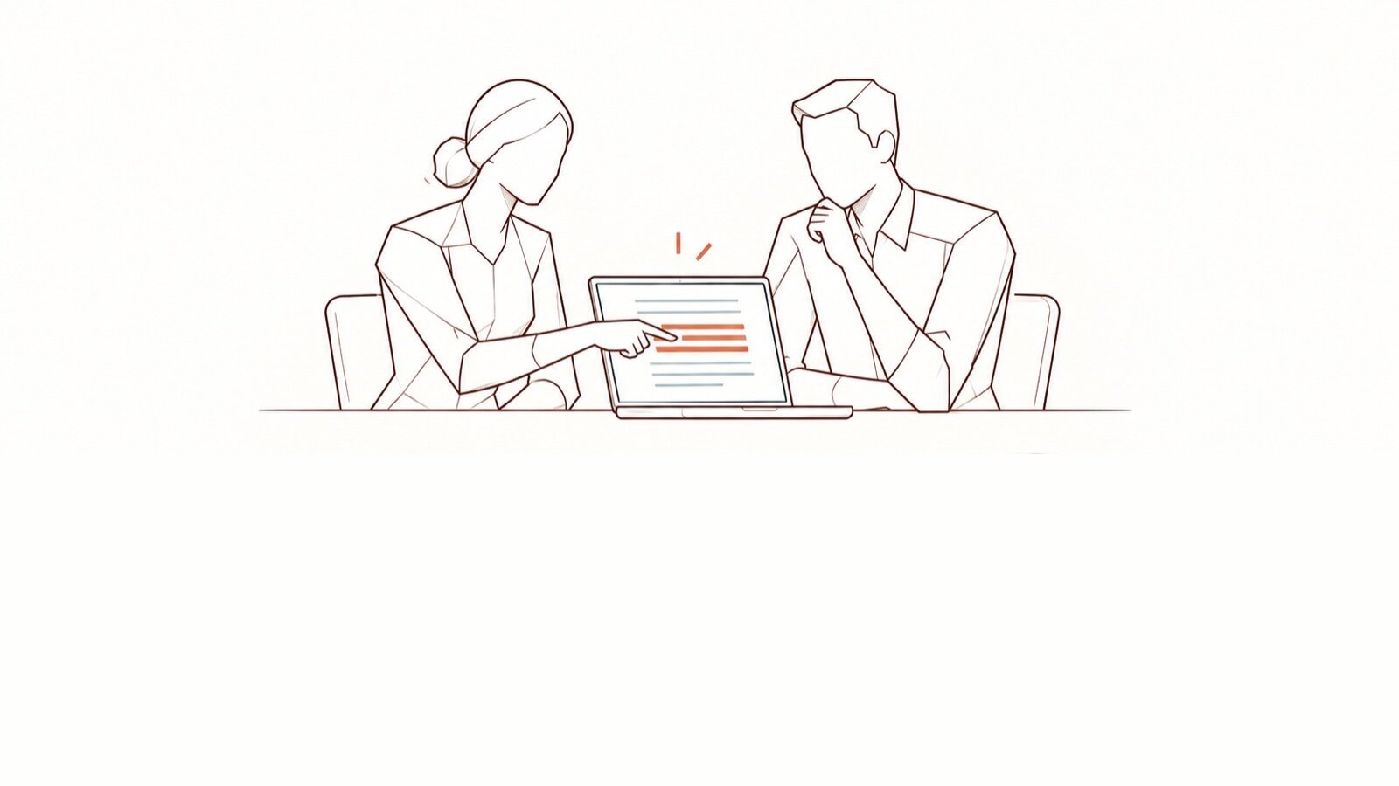
Launch your Seals
Building the Seals community, step by step — the DPO’s guide · [Organisation]
DoNotLeak kit · Contee — an example to adapt, not legal advice
Notes:
For the DPO: how to build the community of Seals (Seal and Engage Against Leaks; “Champions du colmatage” in French), before training them with the kit’s “The Seals” deck.
Picture: “learning in the gesture”, DoNotLeak picture set. The picture’s limit: an adoption goal to be measured, not a teaching gain already proven.

Slide 2



Why a community
Close to the gesture
A living charter
The DPO is no longer alone
A colleague in the team answers when the question comes up, not three weeks later.
The Seals bring back the cases the charter does not cover: it gets better.
Prevention becomes shared work, with clear roles and resources.
DoNotLeak kit · Contee — an example to adapt, not legal advice
Notes:
The AI Act (article 4) asks for measures supporting the AI literacy of staff; a community of relays is one of them, alongside training for everyone. No certificate is required.

Slide 3
The launch, in five steps
A sponsor, time granted
The call for volunteers
The two-hour training
The first meeting
The first demos
One Seal for [number] people, in every team: the ratio is yours to set.
Volunteers, never appointed.
DoNotLeak kit · Contee — an example to adapt, not legal advice
Notes:
Without time granted by the managers, a community of volunteers runs out of steam: that is the first step, before the call. The text of the call for volunteers is in “Templates to copy”.

Slide 4
Who to recruit, and what you give them
The profile
What you give them
What you never ask of them
Volunteers, from every job
Curious about AI, not necessarily experts
Listened to by their colleagues
At least one per team
[x hours a month], granted by the manager
The two-hour training, the attestation
Materials: webinar, charter, templates
Levels and badges
To watch their colleagues
To read others’ texts
To sanction or investigate
DoNotLeak kit · Contee — an example to adapt, not legal advice
Notes:
The role is also described by what it is not: say so in the call for volunteers, and to the works council.

Slide 5
Before the call for volunteers
A sponsor on the executive committee
The Seals’ time granted by the managers
The charter approved, the incident contact published
DPO
Managers
DPO
✓
✕
✓
✕
✓
✕
The Seals’ channel open
The works council informed, where required
The date of the first training set
IT
DPO and HR
DPO
✓
✕
✓
✕
✓
✕
DoNotLeak kit · Contee — an example to adapt, not legal advice
Notes:
Then, to keep the community alive: the Seals’ newsletter, the badge catalogue and a game — they wait for their forms in Show and their pictures at Contee-Design.

Slide 6
A community that seals leaks, watching no one.
[DPO’s name] · [address]
1.
Name the sponsor and set the time granted
2.
Send the call for volunteers before [date]
3.
Schedule the two-hour training: [date]
DoNotLeak kit · Contee — an example to adapt, not legal advice

Slide 7
Licence — keep this notice
Source
Adapted from the DoNotLeak kit published by Contee (https://donotleak.contee.eu/dpo) under the Creative Commons Attribution-ShareAlike 4.0 licence (CC BY-SA 4.0, https://creativecommons.org/licenses/by-sa/4.0/deed.en).
What you may do
You may copy, adapt and share it, for any purpose, crediting Contee.
If you adapt it
ShareAlike: if you publish an adapted version, publish it under the same licence, so that everyone can benefit from the improvements in turn.
DoNotLeak kit · Contee — an example to adapt, not legal advice
Notes:
This notice stays on the last page of any adapted version: it is the condition of the CC BY-SA 4.0 licence. An example to adapt, not legal advice.

