Slide 1
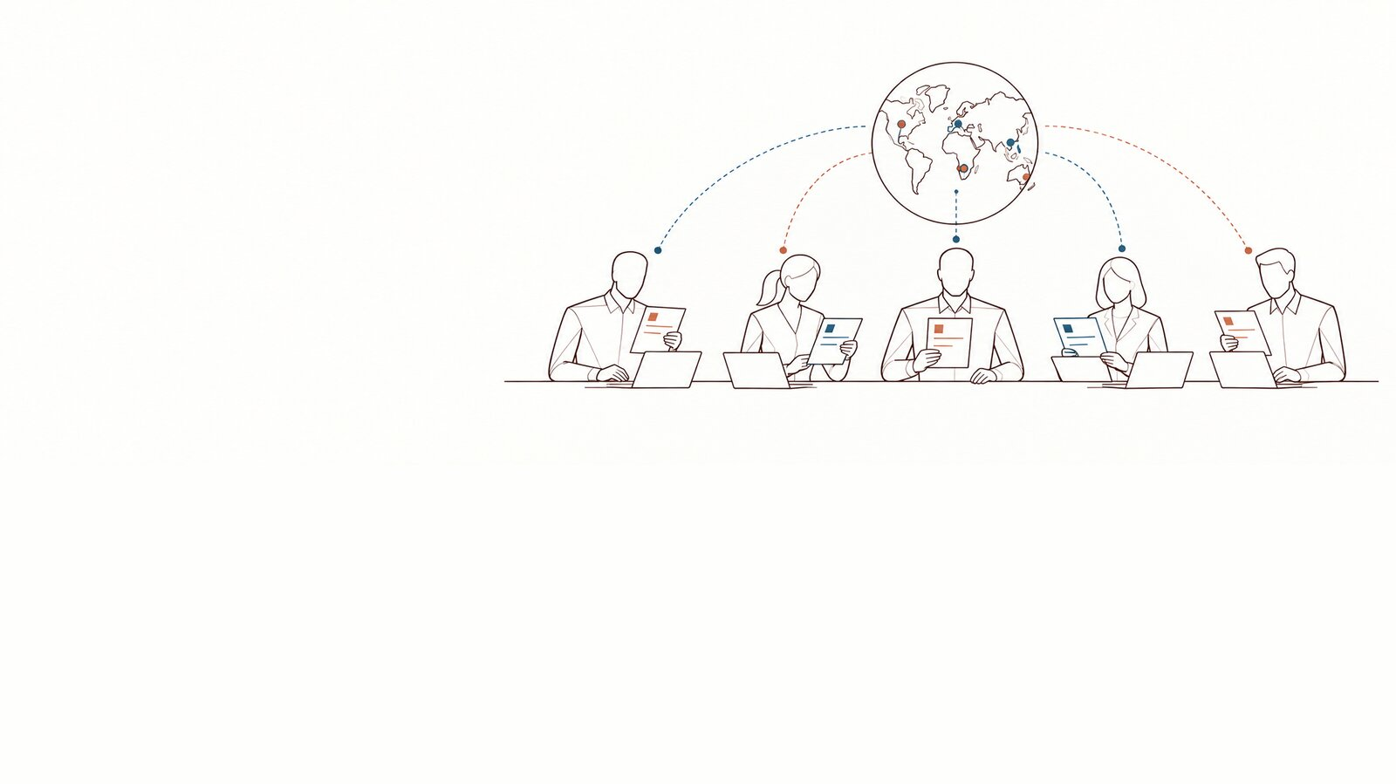
The Seals
Seal and Engage Against Leaks — the two-hour training · [Organisation] · [date]
DoNotLeak kit · Contee — an example to adapt, not legal advice
Notes:
Welcome. Say: “You volunteered to pass on a reflex, not to watch your colleagues. In two hours: the reflex, the objections, a role play, and how to keep the community alive.”
Seals against Leaks: S.E.A.L. = Seal and Engage Against Leaks; in French, the “Champions du colmatage”.
Picture: the panorama “caution becomes collective” from the DoNotLeak picture set, until the scene requested from Contee-Design arrives (S-4: the Seals’ monthly meeting). The picture’s limit: a vision of governance and adoption, not a legal transfer of responsibility.

Slide 2
Two hours, six parts
Step 1
Welcome
The role, and what it is not
One question per person
10 min
Step 2
The reflex
The demo on a fictional text
The sorting exercise
20 min
Step 3
The objections
Four objections, four answers
The quiz: the first move
20 min
Step 4
The role play
“Monday, 9 a.m.”, in threes
Play, swap roles, debrief
30 min
Step 5
Running the community
Rituals, levels, points
The network: core, active, relays
25 min
Step 6
Attestation
Open questions
The attestation handed to each
15 min
Total: 2 h
DoNotLeak kit · Contee — an example to adapt, not legal advice
Notes:
The run of show is an example: it fits two hours with eight to twelve participants.

Slide 3
S.E.A.L. — Seal and Engage Against Leaks
S
Seal
Spot what would leave and protect it before sending.
E
Engage
Pass the reflex on in your team, answer the questions.
A
Against
Not against colleagues, not against AI — against the leak nobody decided.
L
Leaks
People’s data, access keys, confidential documents.
Seal: the animal, and the seal that closes — the Seals, against leaks.
DoNotLeak kit · Contee — an example to adapt, not legal advice
Notes:
The English word seal names both the animal and the wax seal; to seal is to close a gap. In French, the role is called “Champions du colmatage”.
The Seals’ emblem (a seal putting a patch on a crack) is requested from Contee-Design (S-1); the mascot is to be settled with Contee’s visual world. This form carries no picture today.

Slide 4
The role of a Seal
Pass the reflex on
Answer questions
Bring things back
What it never does
Show the tool on a fictional text
Recall the charter at the right moment
Which tool for which use
Where to find the approved tools
Incidents, to the charter’s contact
Exceptions, requests for tools
Lessons, without names
Watch colleagues
Read others’ texts
Sanction or denounce
DoNotLeak kit · Contee — an example to adapt, not legal advice
Notes:
A Seal is neither an inspector nor a lawyer: they help at the moment of the gesture and point the way. An incident belongs to the charter’s contact and to the organisation, which assesses and notifies.

Slide 5
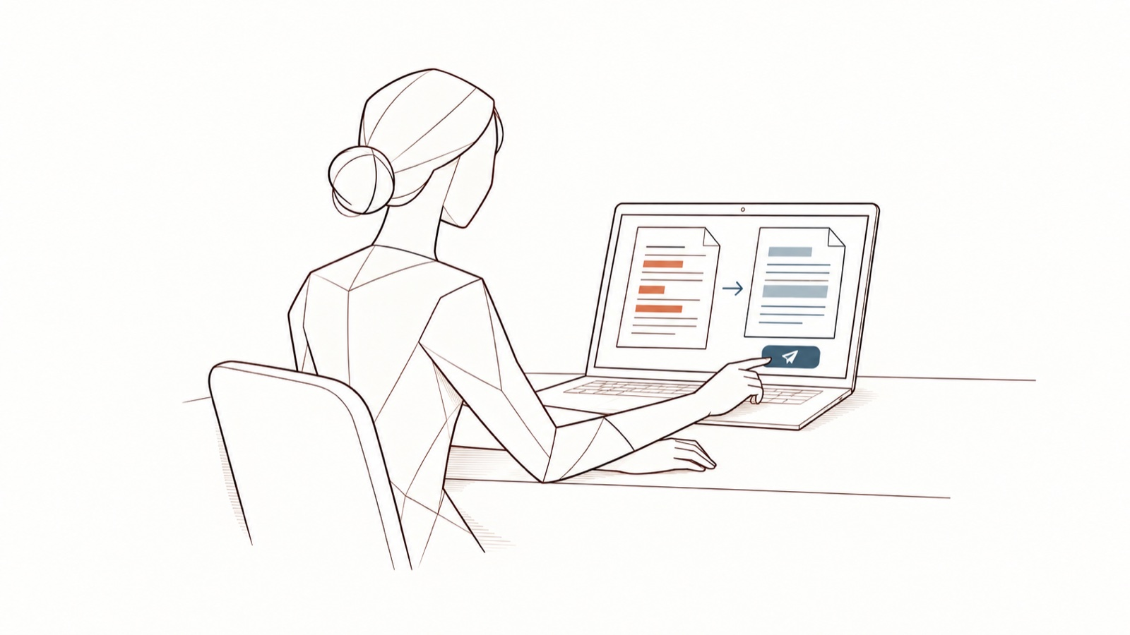
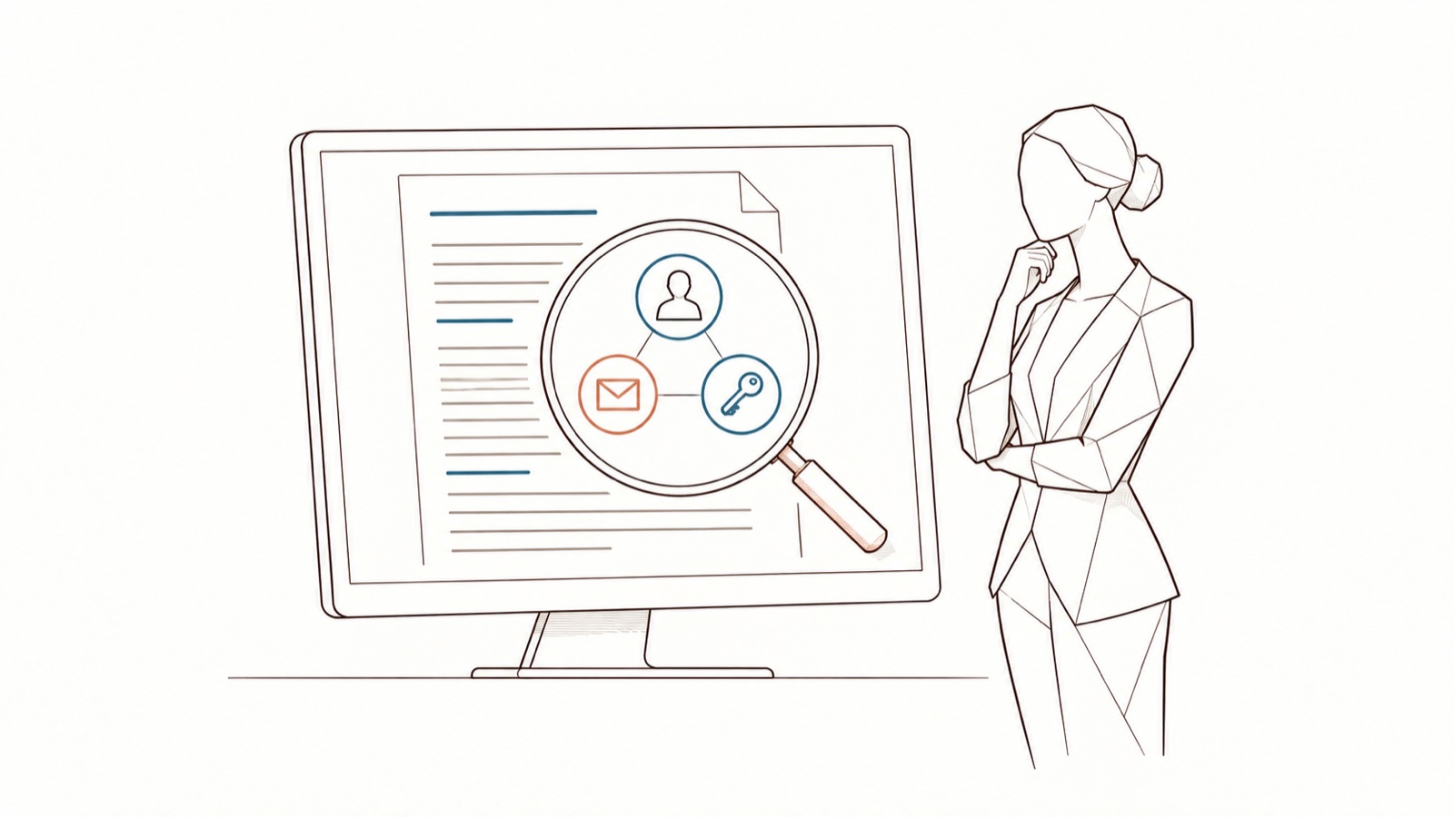
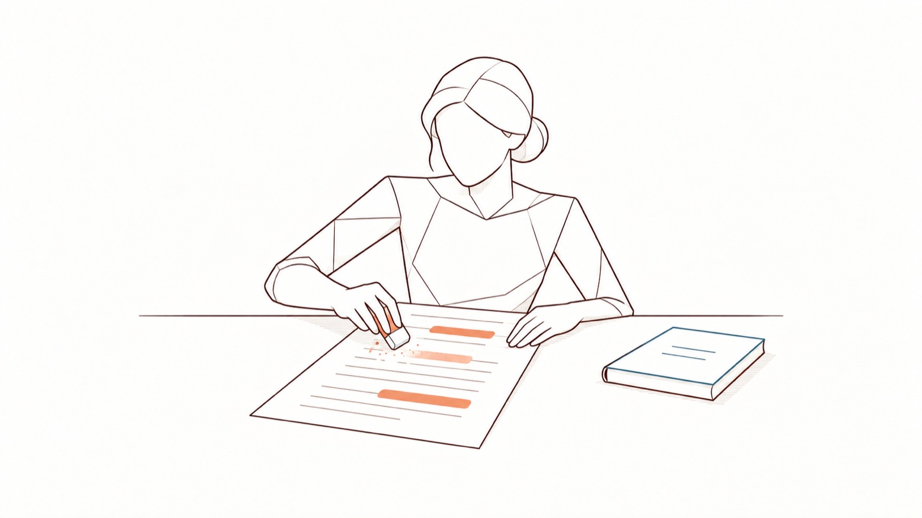
The reflex, in four panels
Monday, 9 a.m. A client email to rephrase: she pastes it into the page first.
Three items stand out.
She decides: keep, replace.
Protected text, approved tool.
DoNotLeak kit · Contee — an example to adapt, not legal advice
Notes:
A fictional scenario. The panels borrow three scenes from the DoNotLeak picture set; a dedicated strip, with one recurring character, is requested from Contee-Design (BD-2).
The pictures’ limits: an illustration of the path, not a screenshot of the interface; detection flags candidates, context is still needed; the choice to keep a value belongs to the user, and the risk depends on the context.

Slide 6
Paste as is, or protect first?
Sorting exercise
Paste as is
Protect first
A public page of the charter
A candidate’s CV
An API key in a code snippet
A patient’s letter
A grammar question
A client’s email
A quote received under an NDA
A question about a spreadsheet formula
DoNotLeak kit · Contee — an example to adapt, not legal advice
Notes:
Have the room sort out loud, then move to the answer. Two traps: the API key — a leaked access secret is revoked and replaced; the quote under a confidentiality agreement — replacing the names is not enough, remove what the agreement protects. Health data never goes into an AI tool without written approval (charter, section 4).

Slide 7
Paste as is, or protect first? — the answer
Sorting exercise
Paste as is
Protect first
A question about a spreadsheet formula
A candidate’s CV
A public page of the charter
An API key in a code snippet
A grammar question
A client’s email
A quote received under an NDA
A patient’s letter
DoNotLeak kit · Contee — an example to adapt, not legal advice
Notes:
Whatever is about a person, opens an access or commits [Organisation] is protected first. A general question is pasted as is.

Slide 8
Quiz — the first move
Quiz
A colleague tells you he pasted a client file into a personal AI account. What is the first move?
A
Reassure him: it is probably nothing
B
Tell the charter’s contact right away
C
Delete the conversation yourself, and say nothing
D
Alert his manager so that he is sanctioned
DoNotLeak kit · Contee — an example to adapt, not legal advice

Slide 9
Quiz — the first move, the answer
Quiz
A colleague tells you he pasted a client file into a personal AI account. What is the first move?
A
Reassure him: it is probably nothing
B
Tell the charter’s contact right away
✓
C
Delete the conversation yourself, and say nothing
D
Alert his manager so that he is sanctioned
Say it right away: an early report beats a perfect one, and no one is blamed for reporting.
DoNotLeak kit · Contee — an example to adapt, not legal advice
Notes:
Containing comes next: delete the conversation where the service allows it, have the keys revoked. The organisation assesses; a personal data breach is notified to the supervisory authority — in France, the CNIL — within 72 hours where feasible, unless it is unlikely to result in a risk (GDPR, art. 33).

Slide 10
Four objections, four answers
The objection
The answer
“I don’t have the time”
A few seconds, on the page, with no account and nothing to install
“IT should just block it”
Blocks get bypassed: the decision is made at the moment of the gesture
“I’ll be watched”
Volumes, never people: nobody reads what you paste
“Our internal AI is enough”
Even an approved tool only gets what the task needs
DoNotLeak kit · Contee — an example to adapt, not legal advice
Notes:
The scanned text is processed in memory, then forgotten: neither stored nor logged (DoNotLeak’s Security page). The charter sets what each tool may receive: even an approved tool only gets what is needed.

Slide 11
“Monday, 9 a.m.” — the role play
Monday, 9 a.m. A colleague comes to see his team’s Seal: on Friday evening, in a hurry, he pasted a list of clients and their phone numbers into an AI assistant opened with his personal account. He is afraid of being sanctioned.
The scene
The colleague
The Seal
The observer
Worried, a little defensive
Listening, without judgement
Silent
You play it down at first: “it was only a list”. You only tell everything if you are listened to without blame.
Listen without blame, point to the charter’s contact, help contain. You do not judge, do not sanction and do not read the conversation.
Note the moment the colleague opens up, the first concrete action proposed, and any word that sounds like blame.
DoNotLeak kit · Contee — an example to adapt, not legal advice
Notes:
A fictional scenario. Print one card per role if you wish.
The scene requested from Contee-Design (S-5: a colleague comes to see a Seal after a mistake; she listens without blame) will accompany this slide; the form carries no picture today. Limit: a Seal does not sanction and does not read other people’s exchanges.

Slide 12
In threes, twenty minutes
20 minutes
in threes
three rounds
1. Each takes a role and reads the brief
2. Play the scene: 4 minutes
3. Debrief: the observer speaks first, 2 minutes
4. Swap roles and play again, up to three rounds
DoNotLeak kit · Contee — an example to adapt, not legal advice
Notes:
In the group debrief: what made the colleague talk? Which sentence shut him down?

Slide 13
After a mistake: the Seal’s part
Listen without blame
Point to the charter’s contact
Help contain: delete, revoke
Bring the lesson back, no names
DoNotLeak kit · Contee — an example to adapt, not legal advice
Notes:
A text sent to an AI cannot be recalled — DoNotLeak cannot do it either: what matters is speed. A Seal does not investigate: the organisation assesses and notifies when the law requires it (GDPR, art. 33).
The comic strip requested from Contee-Design (BD-3: “Report fast”) will accompany this slide. Limit: DoNotLeak does not recall data already sent and revokes nothing for you; no one is sanctioned for reporting.

Slide 14
The rituals, over six months
Seals’ meeting
once a month
Seals’ newsletter
between two meetings
Quarterly challenge
one a quarter
Team demo
every fortnight, one team
Month 1
Month 2
Month 3
Month 4
Month 5
Month 6
Size ∝ the time it takes
DoNotLeak kit · Contee — an example to adapt, not legal advice
Notes:
An example rhythm. The Seals’ newsletter and the badges wait for their forms in Show (newsletter, badge catalogue); the monthly meeting is enough to start.

Slide 15
Three levels, and what each asks
The attestation and the Patch badge
The Rivet badge, the demo materials
The Great Seal badge, a meeting to lead
Rewards
Levels
1
2
3
Patch
Rivet
Great Seal
Take the two-hour training
Run a demo in your team
Turn a lesson into a charter change
Challenges
DoNotLeak kit · Contee — an example to adapt, not legal advice
Notes:
The level names are a proposal to adapt: a patch and a rivet seal a leak; the Great Seal plays on the double meaning of seal (the animal, the wax seal). The three badges are requested from Contee-Design (S-3): a patch; a patch and a rivet; the seal in a medallion.

Slide 16
The points — an example to adapt
+5
Demo
Run a demo of the tool in a team, on a fictional text.
+3
Question
Answer a question and add it to the Seals’ FAQ.
+3
Lesson
Bring an incident’s lesson to the meeting, with no name or detail that points to anyone.
+10
Improvement
Propose a change the committee adopts in the charter or the list of tools.
Points open the levels; the meeting celebrates the quarter’s contributions.
No points for reporting a colleague, nor for a number of incidents: we count useful gestures.
✓ Each quarter
✗ Never
DoNotLeak kit · Contee — an example to adapt, not legal advice
Notes:
Points for gestures that help, never for faults found in others. You may also show no points at all: the levels are enough.

Slide 17
The network, from the core to the relays
Occasional relays
Active Seals
DPO, leads
DoNotLeak kit · Contee — an example to adapt, not legal advice
Notes:
The core prepares the meetings and the materials; active Seals run their team; occasional relays pass on a question or a lesson when one comes up. Anyone can move from one circle to another.

Slide 18
Training attestation
[Organisation] attests that [First Last] took the Seals training, two hours, on [date].
A record of training, not a certification: the AI Act requires none. For [Organisation]: [name, role, signature].
DoNotLeak kit · Contee — an example to adapt, not legal advice
Notes:
One page per person: duplicate the slide, fill it in, print it or export it as PDF. It keeps a record of an AI literacy measure (AI Act, article 4); no certificate is required. Show still lacks an “attestation” form; the attestation seal is requested from Contee-Design (A-1).

Slide 19
Sealing together, watching no one.
Next Seals’ meeting: [date] · [channel]
1.
Show the tool in your team before [date]
2.
Join the Seals’ channel: [link]
3.
Bring your questions to the meeting on [date]
DoNotLeak kit · Contee — an example to adapt, not legal advice

Slide 20
Licence — keep this notice
Source
Adapted from the DoNotLeak kit published by Contee (https://donotleak.contee.eu/dpo) under the Creative Commons Attribution-ShareAlike 4.0 licence (CC BY-SA 4.0, https://creativecommons.org/licenses/by-sa/4.0/deed.en).
What you may do
You may copy, adapt and share it, for any purpose, crediting Contee.
If you adapt it
ShareAlike: if you publish an adapted version, publish it under the same licence, so that everyone can benefit from the improvements in turn.
DoNotLeak kit · Contee — an example to adapt, not legal advice
Notes:
This notice stays on the last page of any adapted version: it is the condition of the CC BY-SA 4.0 licence. An example to adapt, not legal advice.

