Slide 1
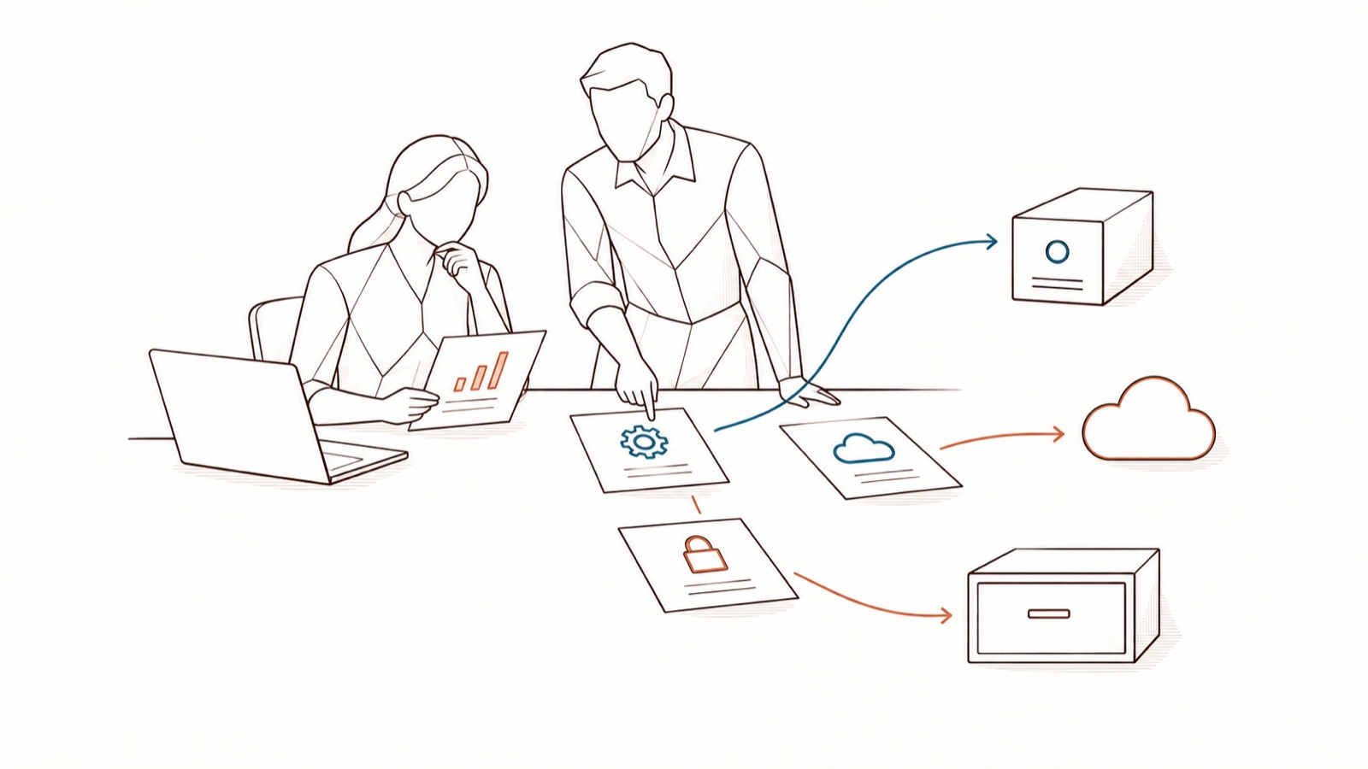
Templates to copy
Emails, register, DPIA, security questionnaire, incidents · [Organisation]
DoNotLeak kit · Contee — an example to adapt, not legal advice
Notes:
The kit’s texts that need no presentation: copy them into your email, your record of processing or your DPIA tool.
Picture: “a known use finds its way”, DoNotLeak picture set. The picture’s limit: a hoped-for governance scene, not an automatic routing feature of DoNotLeak.

Slide 2
How to use
One template per page: copy the text, replace every field in [brackets], have your counsel review it.
What is said of DoNotLeak can be checked at donotleak.contee.eu/security: re-read it before use.
DoNotLeak kit · Contee — an example to adapt, not legal advice
Notes:
The answers about DoNotLeak repeat the verified site: the Security, API and hosting, legal notice and terms of use pages. What depends on your organisation stays in [brackets].

Slide 3
Email 1 — management announces the frame
Subject
AI at work: yes, with a frame
From, to
From: [first last, the sponsor’s role] · To: all staff of [Organisation]
Message
Hello everyone,
Many of us already use AI to draft, summarise, translate or code. We want to keep doing so without letting go of what must stay with us: our clients’ and colleagues’ data, our access credentials, our confidentiality commitments.
From [date], [Organisation] adopts a charter for the use of AI tools, gives you a tool that shows, before you send, what would leave, and invites you to a 45‑minute webinar. In every team, the Seals will answer your questions.
What we will not do
Nobody will be watched: we will follow volumes — approved tools, people trained, incidents reported — never what anyone writes.
Links, signature
The charter: [link] · A question: [DPO contact] · [first last, role]
DoNotLeak kit · Contee — an example to adapt, not legal advice

Slide 4
Email 2 — the webinar invitation
Subject
45 minutes to use AI without leaks — on [date]
Message
Hello,
On [date] at [time], [name] shows in 45 minutes what becomes of a text pasted into an AI tool, who answers for what, and the right reflex before every prompt, with a live demonstration on a fictional text. No prerequisites.
To join: [meeting link or room].
Before you come
Think of a time you wondered whether you could paste a text: we will talk about it.
Signature
[first last, role] · [contact]
DoNotLeak kit · Contee — an example to adapt, not legal advice

Slide 5
Email 3 — the call for Seals
Subject
Become your team’s Seal
Message
Hello,
We are looking for a volunteer in every team to pass on the right reflex with AI and answer colleagues’ questions — the Seals: Seal and Engage Against Leaks. No need to be an expert: curiosity and the wish to help are enough.
You will take a two-hour training, then one meeting a month; [x hours a month] are set aside for it, with your manager’s agreement.
What the role is not
A Seal does not watch colleagues, does not read their exchanges and sanctions no one.
To volunteer
Reply to this message before [date], or write to [contact]. · [first last, role]
DoNotLeak kit · Contee — an example to adapt, not legal advice

Slide 6
Record of processing — the DoNotLeak entry (1/2)
Processing
Protecting work texts before they are sent to an AI tool, with DoNotLeak.
Controller
[Organisation], [address] · representative: [name, role] · DPO: [contact]
Purpose
Finding and replacing, before they are sent to an AI tool or a third party, the personal data, identifiers and access credentials in work texts and documents, to limit what leaves.
Legal basis
[To be qualified with your counsel.]
Data subjects
The people named in the texts processed — [clients, patients, candidates, employees, suppliers…] — and the tool’s users.
Data processed
The content of pasted texts and dropped files (docx, txt or md, up to 10 MB). The tool finds in them, among others: names of people, companies and places; email and postal addresses; phone numbers; IBANs and card numbers; dates of birth; national ID and tax numbers; vehicle plates; keys, tokens and passwords; IPv4 addresses.
DoNotLeak kit · Contee — an example to adapt, not legal advice
Notes:
The fields follow article 30 of the GDPR. What the tool finds: the Shadow AI (“What identifies”) and Security pages of donotleak.contee.eu; the file size: the scan page.

Slide 7
Record of processing — the DoNotLeak entry (2/2)
Recipients
None: DoNotLeak sends the text to no AI provider and no third-party service. Only the protected version, copied by the user, goes on to the AI tool they choose — that processing has its own entry.
Publisher, hosting
Public page: published by AQ INVESTISSEMENTS (Contee), Paris; hosted in the European Union by OVH SAS, a French company. [Contee’s role to be qualified with your counsel: the terms of use contain no processor clauses (GDPR, art. 28).] On your servers: [your hosting].
Transfers outside the EU
None: DoNotLeak calls no service and the page is hosted in the European Union. [On your servers: depends on your hosting.]
Retention
None for the texts: processed in memory for the time of the scan, then forgotten, neither stored nor logged. The host’s technical logs (IP address, date, page requested), without the text: [period to ask Contee].
Security measures
HTTPS only; no outbound connection; images signed and scanned before release, with their software bill of materials; isolated, read-only execution; API closed by default (client certificate or token, deny by default). Details: donotleak.contee.eu/security.
DoNotLeak kit · Contee — an example to adapt, not legal advice
Notes:
Sources: legal notice (publisher, host, personal data, the host’s logs) — https://donotleak.contee.eu/legal ; terms of use — https://donotleak.contee.eu/terms ; Security page — https://donotleak.contee.eu/security ; API and hosting page — https://donotleak.contee.eu/integration.

Slide 8
Elements for your DPIA (1/2) — the processing
Description
Before sending a text to an AI tool, the person pastes it into DoNotLeak, which finds personal data, identifiers and access credentials, shows each with its type and replaces it with a label ([[PERSON-1]]) or a plausible value. The person keeps what their task needs, decides, then copies the protected version.
Data flow
On the public page, the text travels encrypted (HTTPS) from the browser to the server, is analysed in memory, then forgotten; the answer returns to the browser. No call to an AI provider or any third party. On your servers, the text never leaves your information system.
Necessity, proportionality
The tool reduces what goes to AI tools (data minimisation, GDPR, art. 5.1.c); it keeps nothing and asks for no account. [To be assessed by [Organisation]: the uses and data categories concerned.]
Is a DPIA required?
[To be assessed by [Organisation] with its DPO, in the light of its processing (GDPR, art. 35).]
DoNotLeak kit · Contee — an example to adapt, not legal advice
Notes:
Elements to reuse in your impact assessment, not an impact assessment: it belongs to [Organisation]. Replacing is pseudonymising, not anonymising: pseudonymised data remains personal data (GDPR, article 4.5, recital 26).

Slide 9
Elements for your DPIA (2/2) — risks and measures
What the tool does not cover
No detection finds everything; a trade secret written in plain words can get through; replacing is pseudonymising, not anonymising; it protects only what passes through it; it cannot recall a text already sent; a compromised device reads the text before it does.
Technical measures
Nothing is kept — every release sends a canary text through the server and fails if its logs ever show it; no outbound connection; signed and scanned images; isolated execution; HTTPS and a strict content policy; API on identity, deny by default.
Organisational measures
The charter, training for everyone and for the Seals, review before sending, the incident path, measurement by volumes.
Residual risk
[To be assessed by [Organisation]: likelihood, severity, decision.]
DoNotLeak kit · Contee — an example to adapt, not legal advice
Notes:
Source: DoNotLeak’s Security page, “What DoNotLeak does not protect against” and “Ten controls in place today” — https://donotleak.contee.eu/security

Slide 10
Security questionnaire (1/3) — the data
Is any data kept?
No. Text and files live in the memory of the request, then disappear: never written to disk, never logged. Evidence: Security page, “Nothing kept”; legal notice, “Personal data”.
Logs, traces?
The service never logs the text; every pipeline sends a canary text through it and fails if the logs show it. The host may keep connection logs (IP, date, page), without the text. Evidence: Security page; legal notice.
Third parties, processors?
Detection calls no one: no AI provider, no third-party service, no outbound network access. Host: OVH SAS. Evidence: Security page, “No outbound connection”.
Where is it hosted?
In the European Union, by OVH SAS, a French company; publisher AQ INVESTISSEMENTS (Contee), Paris. Or on your own servers. Evidence: legal notice; API and hosting page.
Is an AI model used?
No: formats, rules and dictionaries; no language model. Evidence: API and hosting page, “No one else called”.
DoNotLeak kit · Contee — an example to adapt, not legal advice

Slide 11
Security questionnaire (2/3) — security
Encryption in transit?
HTTPS only, with strict-transport-security. Evidence: the response headers of any page.
Access control?
Page: no account, with per-client budgets. API: no anonymous call; a client certificate (mutual TLS) or an OpenID Connect token; each action granted by name, deny by default. Evidence: API and hosting page.
Vulnerabilities?
Two independent scanners examine every image; a high or critical flaw stops the pipeline, unless a written, reviewed exception says why; the running service is probed; dependencies are checked against the public vulnerability database. Evidence: Security page.
Release integrity?
Every image is signed with DoNotLeak’s own key, with its build provenance and its software bill of materials. Evidence: the public key and the verification command, Security page.
Hardening?
A minimal image, no shell or package manager, an unprivileged user; a user-space kernel, no Linux capabilities, a read-only file system, memory and CPU limits. Evidence: Security page.
DoNotLeak kit · Contee — an example to adapt, not legal advice

Slide 12
Security questionnaire (3/3) — the rest
Reporting a flaw?
The security contact is published in /.well-known/security.txt (RFC 9116); languages read: French and English. Evidence: the file on the site.
Certifications?
None claimed: the Security page describes technical controls, neither a certification nor legal advice. [Penetration tests, audits: ask Contee.]
Availability?
The public page is provided as is; the service may be interrupted, in particular for maintenance or security (terms of use). [Service commitment: ask Contee.]
Known limits?
No detection finds everything; it protects only what passes through it; it cannot recall a sent text or revoke a key; a compromised device reads the text first. Evidence: Security page, “What DoNotLeak does not protect against”.
On your servers?
A headless server image, amd64 and arm64, behind your PKI and your identity provider: texts never leave your perimeter. [Delivery terms: ask Contee.]
DoNotLeak kit · Contee — an example to adapt, not legal advice
Notes:
Sources: https://donotleak.contee.eu/security ; https://donotleak.contee.eu/integration ; https://donotleak.contee.eu/legal ; https://donotleak.contee.eu/terms ; https://donotleak.contee.eu/.well-known/security.txt

Slide 13
Reporting an incident — the form
Question | Your answer
When did it happen? (date, time) | DD/MM/YYYY, hh:mm
Which tool or service received the information? With which account: work or personal? | Tool name, account type
What left? Data about people, an access key, a confidential document — describe it without copying it. | The kind, not the data
Roughly how many people or documents are concerned? | An order of magnitude is enough
What have you already done? Conversation deleted, key reported… | What is done, what is left
Your name and team, so that we can call you back | Name, team, phone
How to use it
Send it right away to [the charter’s contact], even incomplete: a quick report beats a perfect one, and nobody is blamed for reporting. Never copy the exposed data into this form.
DoNotLeak kit · Contee — an example to adapt, not legal advice
Notes:
The form feeds the organisation’s assessment; it is not there to find someone to blame. A text sent to an AI cannot be recalled: speed is what counts.

Slide 14
Notifying the authority — the elements (art. 33)
When
Without undue delay and, where feasible, within 72 hours of becoming aware of it, unless the breach is unlikely to result in a risk to people; after that, give the reasons for the delay. In France: the CNIL’s online service.
The breach
Nature: [what happened, the tool concerned] · categories and approximate number of data subjects: [to fill in] · categories and approximate number of records: [to fill in].
The contact
[Name and contact details of the DPO or another contact point].
Likely consequences
[What may happen to the people concerned.]
The measures
Taken or proposed to address the breach and mitigate its effects: [conversation deleted, key revoked, people informed…].
In every case
Document the breach, its effects and the measures taken, even without notification (art. 33.5).
DoNotLeak kit · Contee — an example to adapt, not legal advice
Notes:
GDPR, article 33, paragraphs 1, 3 and 5 — https://eur-lex.europa.eu/eli/reg/2016/679/oj ; CNIL, notifying a personal data breach — https://www.cnil.fr/fr/services-en-ligne/notifier-une-violation-de-donnees-personnelles. The organisation, as controller, notifies; the DPO advises.

Slide 15
Informing the people concerned — the letter (art. 34)
When
When the breach is likely to result in a high risk to their rights and freedoms: without undue delay, in clear and plain language.
Subject
Information about your personal data
Message
Dear [name],
On [date], [what happened, in plain words]. The information concerned is: [categories]. What this may mean for you: [likely consequences]. What we have done: [measures]. What we advise: [for example, change a password, be wary of an unexpected message].
Contact, signature
For any question: [name and contact details of the DPO]. [First last, role], [Organisation].
DoNotLeak kit · Contee — an example to adapt, not legal advice
Notes:
GDPR, article 34, paragraphs 1 and 2 — https://eur-lex.europa.eu/eli/reg/2016/679/oj. Your counsel checks whether informing people is required, and the wording.

Slide 16
References
Ref.
GDPR, Regulation (EU) 2016/679 — articles 4.5, 5, 28, 30, 33, 34 and 35:
  https://eur-lex.europa.eu/eli/reg/2016/679/oj
CNIL — Notifying a personal data breach (in French):
  https://www.cnil.fr/fr/services-en-ligne/notifier-une-violation-de-donnees-personnelles
DoNotLeak — security, API and hosting, legal notice, terms of use:
  https://donotleak.contee.eu/security · /integration · /legal · /terms
DoNotLeak kit · Contee — an example to adapt, not legal advice

Slide 17
Licence — keep this notice
Source
Adapted from the DoNotLeak kit published by Contee (https://donotleak.contee.eu/dpo) under the Creative Commons Attribution-ShareAlike 4.0 licence (CC BY-SA 4.0, https://creativecommons.org/licenses/by-sa/4.0/deed.en).
What you may do
You may copy, adapt and share it, for any purpose, crediting Contee.
If you adapt it
ShareAlike: if you publish an adapted version, publish it under the same licence, so that everyone can benefit from the improvements in turn.
DoNotLeak kit · Contee — an example to adapt, not legal advice
Notes:
This notice stays on the last page of any adapted version: it is the condition of the CC BY-SA 4.0 licence. An example to adapt, not legal advice.

