Slide 1
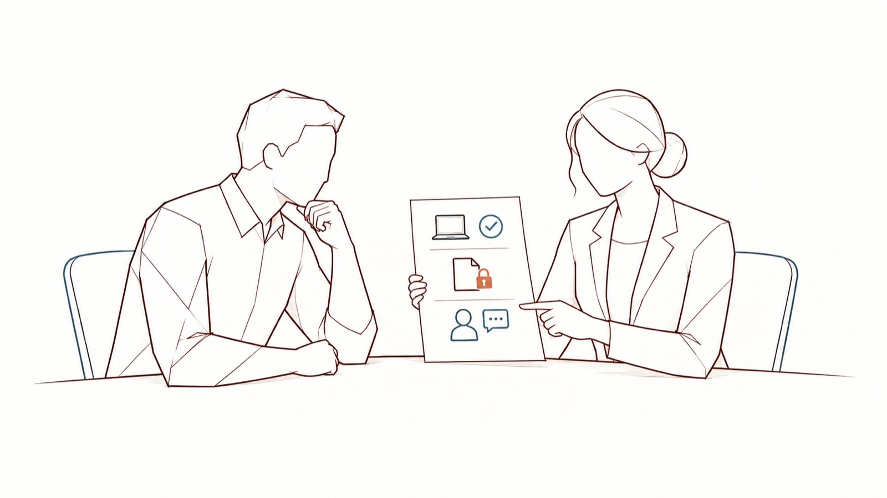
AI and our data — informing the works council
[Organisation] · meeting of [date] · have your counsel review it
DoNotLeak kit · Contee — an example to adapt, not legal advice
Notes:
The four slides for the meeting; the full note, to read and file, is another file in the kit. Have your counsel review it: this is not legal advice.
Picture: the scene “a charter people understand” from the DoNotLeak picture set, until the scene requested from Contee-Design arrives (E-1: employee representatives read a note with the DPO, no camera, no eye). The picture’s limit: a proposed teaching approach; a signature alone guarantees neither adoption nor compliance.

Slide 2
What the tool does, what it never does
What it does
What it never does
Finds personal data and access keys
Shows each detection, before sending
Replaces what the person chooses to protect
Leaves the decision to the person
Keep a copy of the text or log it
Let anyone read what is pasted
Ask for an account, report a person
Decide in someone’s place
DoNotLeak kit · Contee — an example to adapt, not legal advice
Notes:
DoNotLeak watches no one: volumes, never people; nobody’s text is read. The text is processed in memory, then forgotten; the host (OVH SAS, a French company) may keep connection logs — IP address, date, page — that never contain the text. Sources: https://donotleak.contee.eu/security and https://donotleak.contee.eu/legal

Slide 3
The calendar
Works council informed: [date]
Questions and exchanges
Opinion, where the law requires it
Launch: [date]
Review with the council at 90 days
DoNotLeak kit · Contee — an example to adapt, not legal advice
Notes:
In France, in companies of at least fifty employees, the works council (CSE) is informed and consulted on the introduction of new technologies (Labour Code, art. L2312-8) and on the means of monitoring employees’ activity (art. L2312-38): your counsel will say whether and how these articles apply. Outside France, your own rules apply. Légifrance: https://www.legifrance.gouv.fr/codes/article_lc/LEGIARTI000043975196 ; https://www.legifrance.gouv.fr/codes/article_lc/LEGIARTI000035610275

Slide 4
Volumes, never people.
[Name, role — the DPO] · [address]
1.
Read the note and the draft AI charter
2.
Send your questions before [date]
3.
The review with the works council, at 90 days
DoNotLeak kit · Contee — an example to adapt, not legal advice

Slide 5
Licence — keep this notice
Source
Adapted from the DoNotLeak kit published by Contee (https://donotleak.contee.eu/dpo) under the Creative Commons Attribution-ShareAlike 4.0 licence (CC BY-SA 4.0, https://creativecommons.org/licenses/by-sa/4.0/deed.en).
What you may do
You may copy, adapt and share it, for any purpose, crediting Contee.
If you adapt it
ShareAlike: if you publish an adapted version, publish it under the same licence, so that everyone can benefit from the improvements in turn.
DoNotLeak kit · Contee — an example to adapt, not legal advice
Notes:
This notice stays on the last page of any adapted version: it is the condition of the CC BY-SA 4.0 licence. An example to adapt, not legal advice.

